Slide 1
Specifications for Ligature Resistant Locks
New York Office of Mental Health – Specification and Approval of Ligature Resistant Products

Slide 2
TownSteel Ligature Resistant Locks
Ligature Resistant Locks are used to help prevent people from causing self harm by attaching a ligature to the door lock. These are most used in Psychiatric Hospitals, Detention Centers and Behavioral Healthcare settings.
Ligature Resistant lock set:
3pt and 5pt ligature resistant
Ligatures:
  Shoelace
  Guitar string
  Ear bud wire
  Dental floss
  Belt
  Towel, sheet, etc.

Slide 3
TownSteel Ligature Resistant Locks
3-point ligature resistant
5-point ligature resistant
Can pull a ligature in any of these 3 directions - up, down, and left (toward the hinges) - and it will resist any attachment.
Pulling out or towards the latch may cause the ligature to potentially catch
Can pull a ligature in any of these 5 directions - up, down, left, right, and out - and it will resist any attachment.

Slide 4
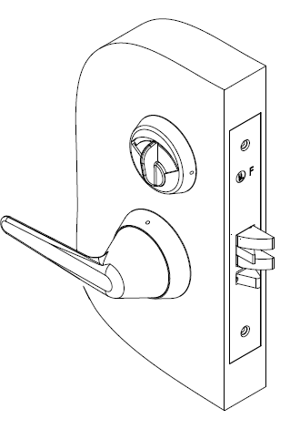
TownSteel Ligature Resistant
RX Series
All trim is solid stainless steel
Lockbodies are heavy duty ANSI rated
Lever designs clutch or rotate up and down (~52°) in locked position to facilitate ligature slippage
Knob designs provide textured surfaces to improve grip
Thumb turn design is ADA compliant or conical knob

Slide 5
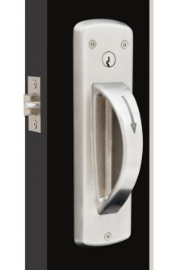
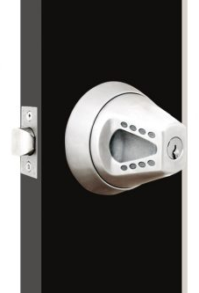
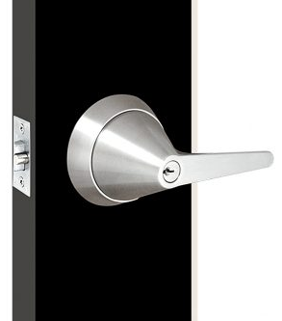
TownSteel Ligature Resistant
RX Series – Cylindrical Locks
Grade 1 cylindrical locks with arch lever, regular lever, or knob
Variety of different functions
  Most common are F-75, F-76, F-84, and F-86
CRX-A and CRX-K are 5-point ligature resistant; TRX-L is 3-point ligature resistant
CRX-A
CRX-K
TRX-L

Slide 6
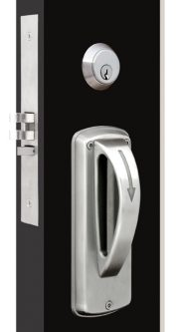
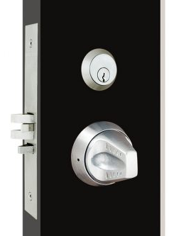
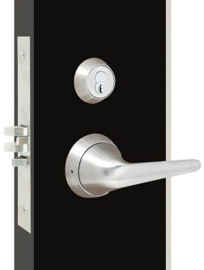
TownSteel Ligature Resistant
RX Series – Mortise Locks
Grade 1 mortise locks with arch lever, regular lever, or knob
Variety of different functions
  Most common are F-01, F-05, F-19, F-26, and F-30
MRX-A and MRX-K are 5-point ligature resistant; MRX-L is 3-point ligature resistant
MRX-A
MRX-K
MRX-L

Slide 7
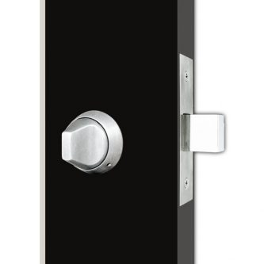
TownSteel Ligature Resistant
RX Series – Deadbolt Locks
Auxiliary deadbolt with knob type thumb turn
DRX is 5-point ligature resistant
DRX

Slide 8
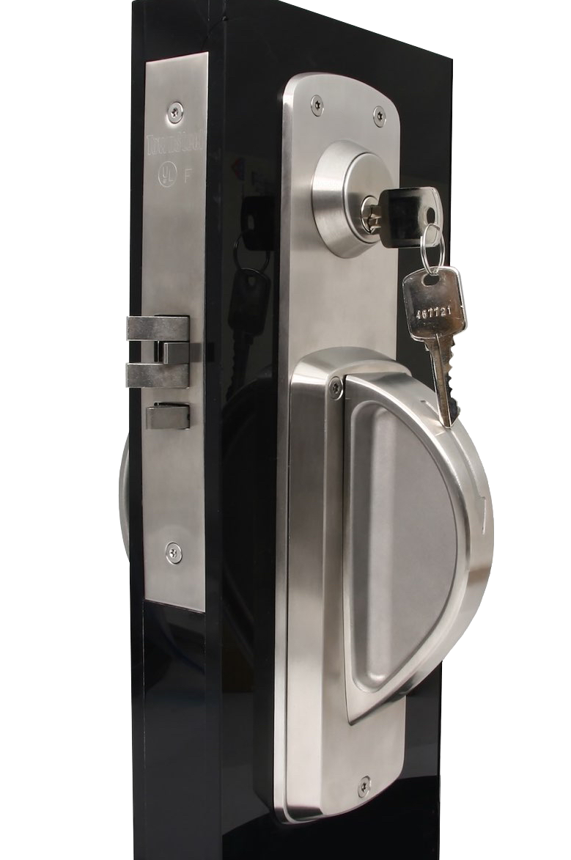
TownSteel Ligature Resistant Rejuvenator
5-point ligature product
Heavy duty ANSI Grade 1 certified
Mortise door prep compatibility with major brand
Fast easy installations
Large Escutcheon underplate conceals all unnecessary holes
Built on cylinder collar removes any ligature point that would have been present

Slide 9
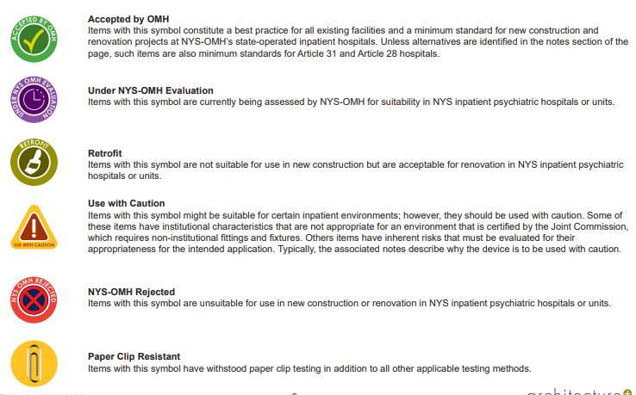
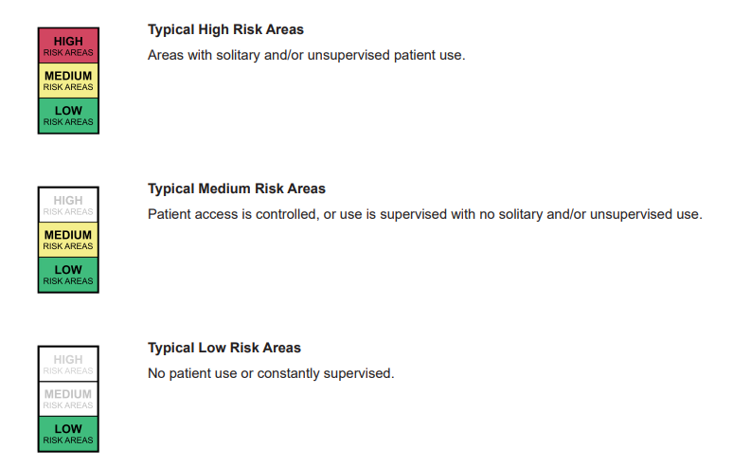
New York Office of Mental Health Standards
As of July 2021
https://omh.ny.gov/omhweb/patient_safety_standards/guide.pdf

Slide 10
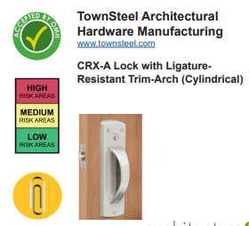
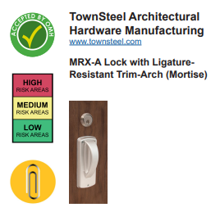
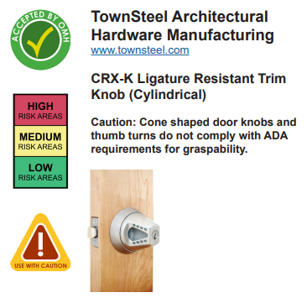
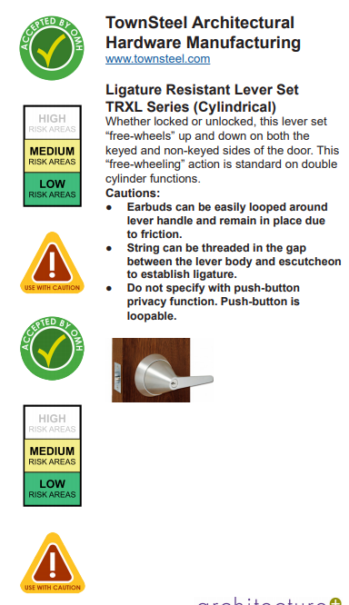
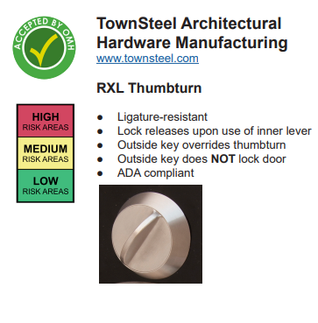
New York Office of Mental Health Patient Standards
As of July 2020
ANSI/BHMA A156.34 Grade 1 Ligature resistant locks

Slide 11
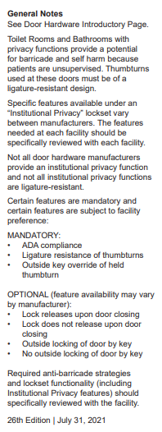
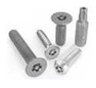
New York Office of Mental Health Patient Standards
As of July 2021
Products listed will be ADA compliant unless otherwise stated.
We manufacture the ligature resistant products so that the mounting screws will be on the outside of the lock, usually locks have the mounting screws accessed on the inside of the lock.
All exposed mounting screws are provided with a tamper resistant heads- usually a Torx® with pin in screw head.
Only finish is 32D- brushed stainless steel. Levers, handles, plates are all solid stainless steel.
Made for 1 ¾” thick doors, can accommodate 1 3/8” and 2” thick doors on some products.
New York Office of Mental Health Patient Standards July 31, 2021

Slide 12
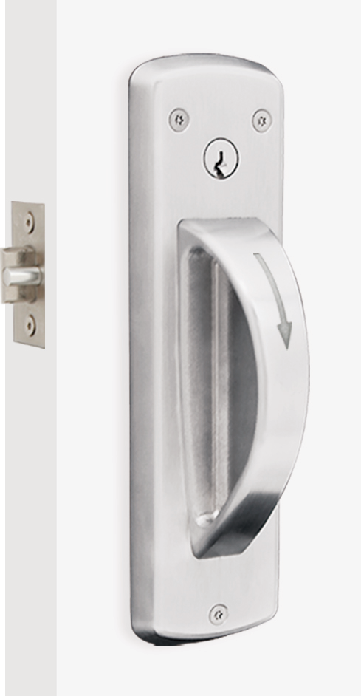
CRX-A Ligature Resistant
Cylindrical Lock
Cylindrical Grade 1, UL listed for a 3-hour fire door
1 ¾” thick doors
  Can accommodate up to 2” thick doors
Tamper resistant screws for mounting
Compatible with standard KIK cylinder, SFIC 6 & 7 pin cores, Sargent, Corbin, Yale, Schlage LFIC cores
Units are handed
2 ¾” backset std, 2 3/8” and 5” backset available
Functions:
  F-75 Passage
  F-76 Privacy
  F-84 Classroom
  F-86 Storeroom
No electrified options available
Find this product at townsteel.com/products/crx-a/

Slide 13
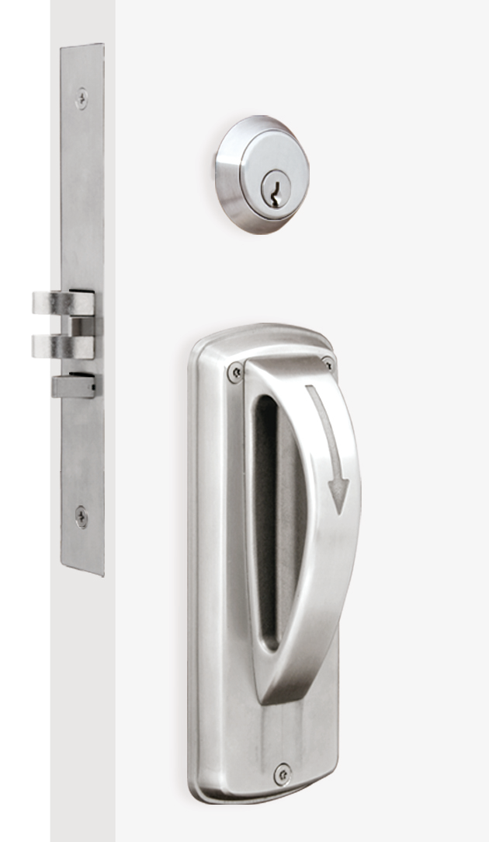
MRX-A Ligature Resistant
Mortise Lock
Non-clutching Mortise Grade 1, UL listed for a 3-hour fire door
1 ¾” thick doors- can accommodate different thicknesses
2 ¾” backset only
Tamper resistant screws for mounting
Compatible with standard mortise cylinder and various IC cores using the TownSteel cam
Units are handed
Uses the non-clutching mortise (MRX-L uses the clutching mortise)
Can handle all standard mortise functions
TownSteel Cam Shape
Find this product at townsteel.com/products/mrx-a/

Slide 14
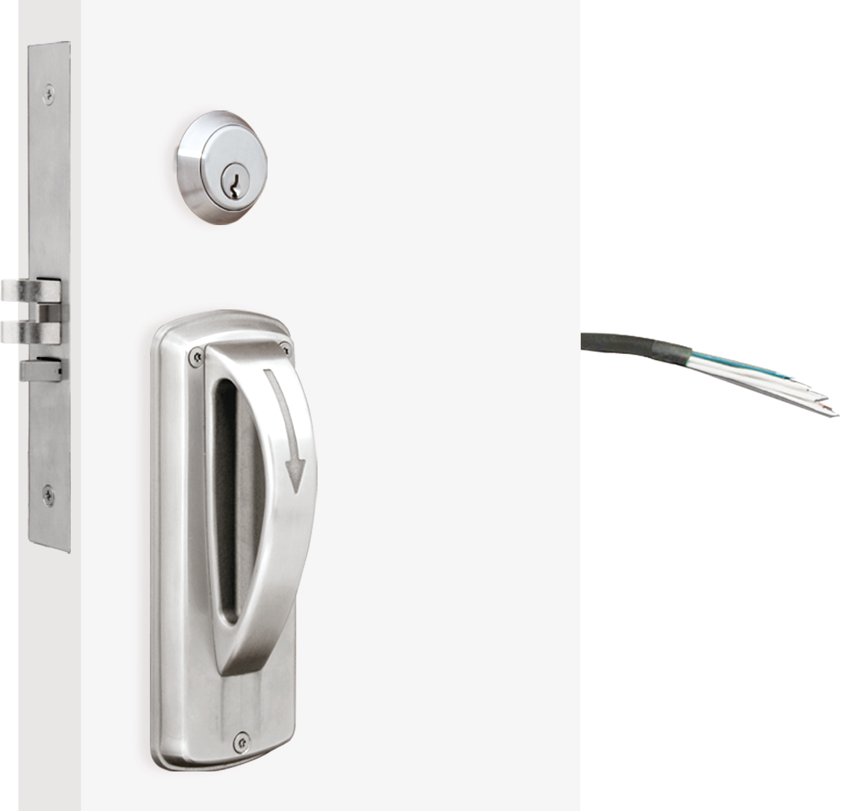
XMRX-A Electrified Ligature Resistant
Mortise Lock
Non-clutching Mortise Grade 1, UL listed for a 3-hour fire door
1 ¾” thick doors- can accommodate different thicknesses
2 ¾” backset only
Tamper resistant screws for mounting
Compatible with standard mortise cylinder and various IC cores
12 or 24 VDC
RQE (request to exit), DP (Door position), LP (Latch position) switches
Fail Safe or Fail Secure
Units are handed
See next slide for functions. Can handle all the standard mortise functions as applicable (except toggle type functions)

Slide 17
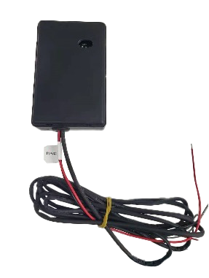
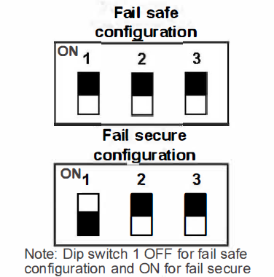
XMRX-A 30X Series Electrified Ligature Resistant Mortise Lock
Non-clutching Mortise Grade 1, UL listed for a 3-hour fire door
1 ¾” thick doors- can accommodate different thicknesses
2 ¾” backset only
Tamper resistant screws for mounting
Compatible with standard mortise cylinder and various IC cores
10-30 VDC using a PCU
RQE (request to exit), DAJ (door ajar), MKO (mechanical key override), PRIV (privacy) switches
Fail Safe or Fail Secure (changeable in field on the PCU)
Units are handed
See next slide for functions. Can handle all the standard mortise functions as applicable (except toggle type functions)

Slide 18
30X Series locks work with 10-30VDC
Fail Safe and Fail Secure is selectable in the field and can easily be changed
Functions:
  LC – less cylinder - can be ordered, or you can simply not install the cylinder; this will eliminate the key override
  DC – deadbolt with cylinder on each side
  C – cylinder on each side
  DB – deadbolt

Slide 19
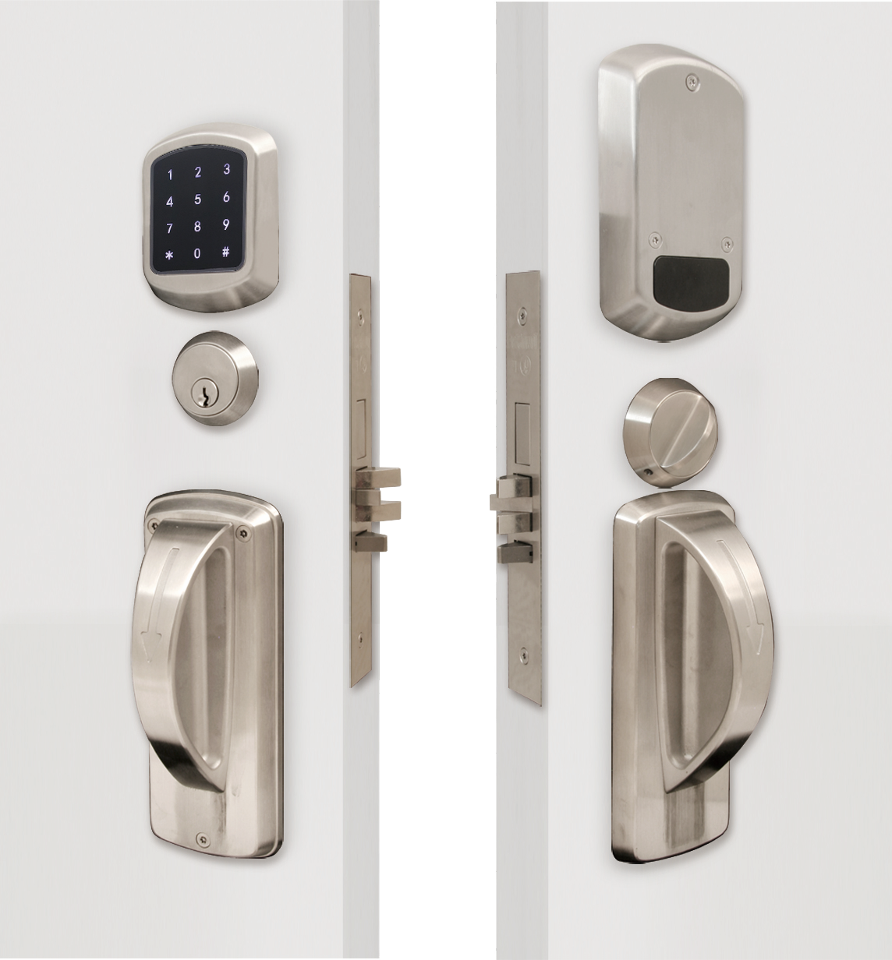
XMRXA Electronic Ligature Resistant
Mortise Lock
Mortise Grade 1, UL listed for a 3-hour fire door
1 ¾” thick doors- can accommodate different thicknesses
2 ¾” backset only
Tamper resistant screws for mounting
Compatible with standard mortise cylinder and various IC cores using the TownSteel cam
Units are handed
Programmable at the lock or with mobile app
4-6 digit PIN (2000 series) or 6-10 digit PIN (4000 / 5000 series), with 100 PIN code capacity (2000 series) or 400 PIN capacity for RFID credentials (4000 / 5000 series)
Battery operated with non-volatile memory and low-battery warning
Can handle all standard mortise functions
XMRXA 5000RF

Slide 20
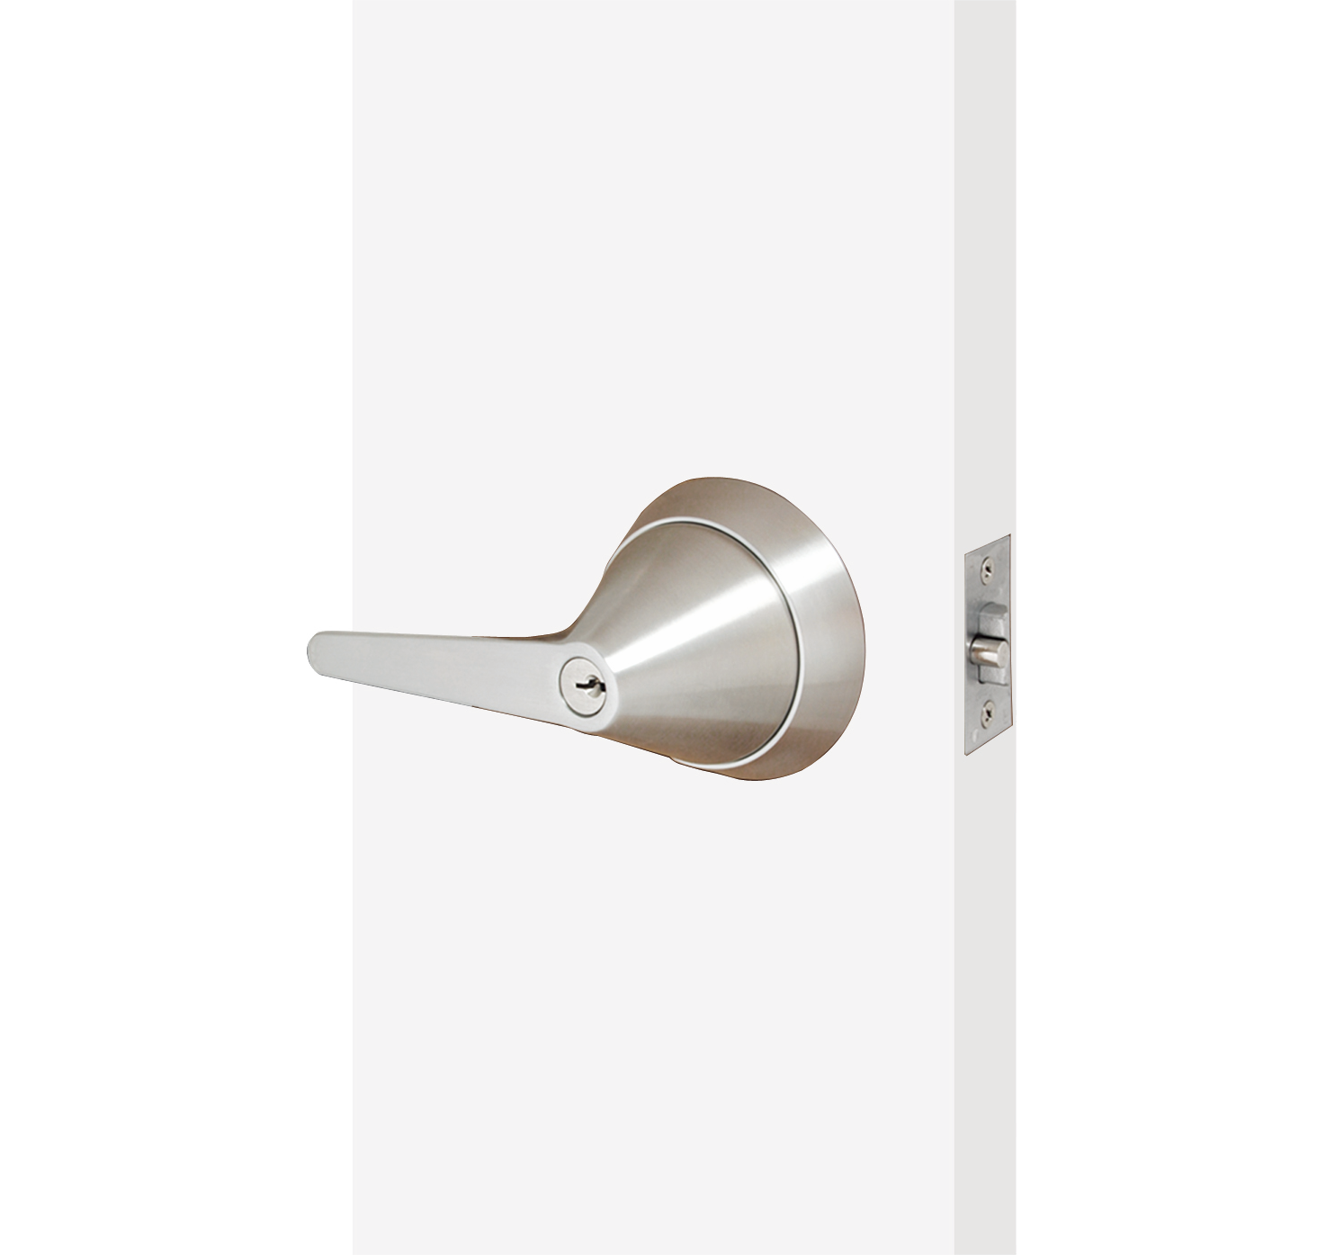
TRX-L Ligature Resistant
Cylindrical Lock
Cylindrical Grade 1, UL listed for a 3-hour fire door
1 ¾” thick doors (can accommodate 1 3/8” w Spacers)
Tamper resistant screws for mounting
Compatible with standard KIK cylinder, SFIC 6 & 7 pin cores, Corbin, Schlage LFIC cores
Units are handed
2 ¾” backset standard, 2 3/8” and 5” backset available
Allen wrench to secure outside lever
Functions:
  F-75 Passage
  F-76 Privacy
  F-84 Classroom
  F-86 Storeroom
  F-87 Asylum
  F-109 Office
Find this product at townsteel.com/products/trx-l/

Slide 21
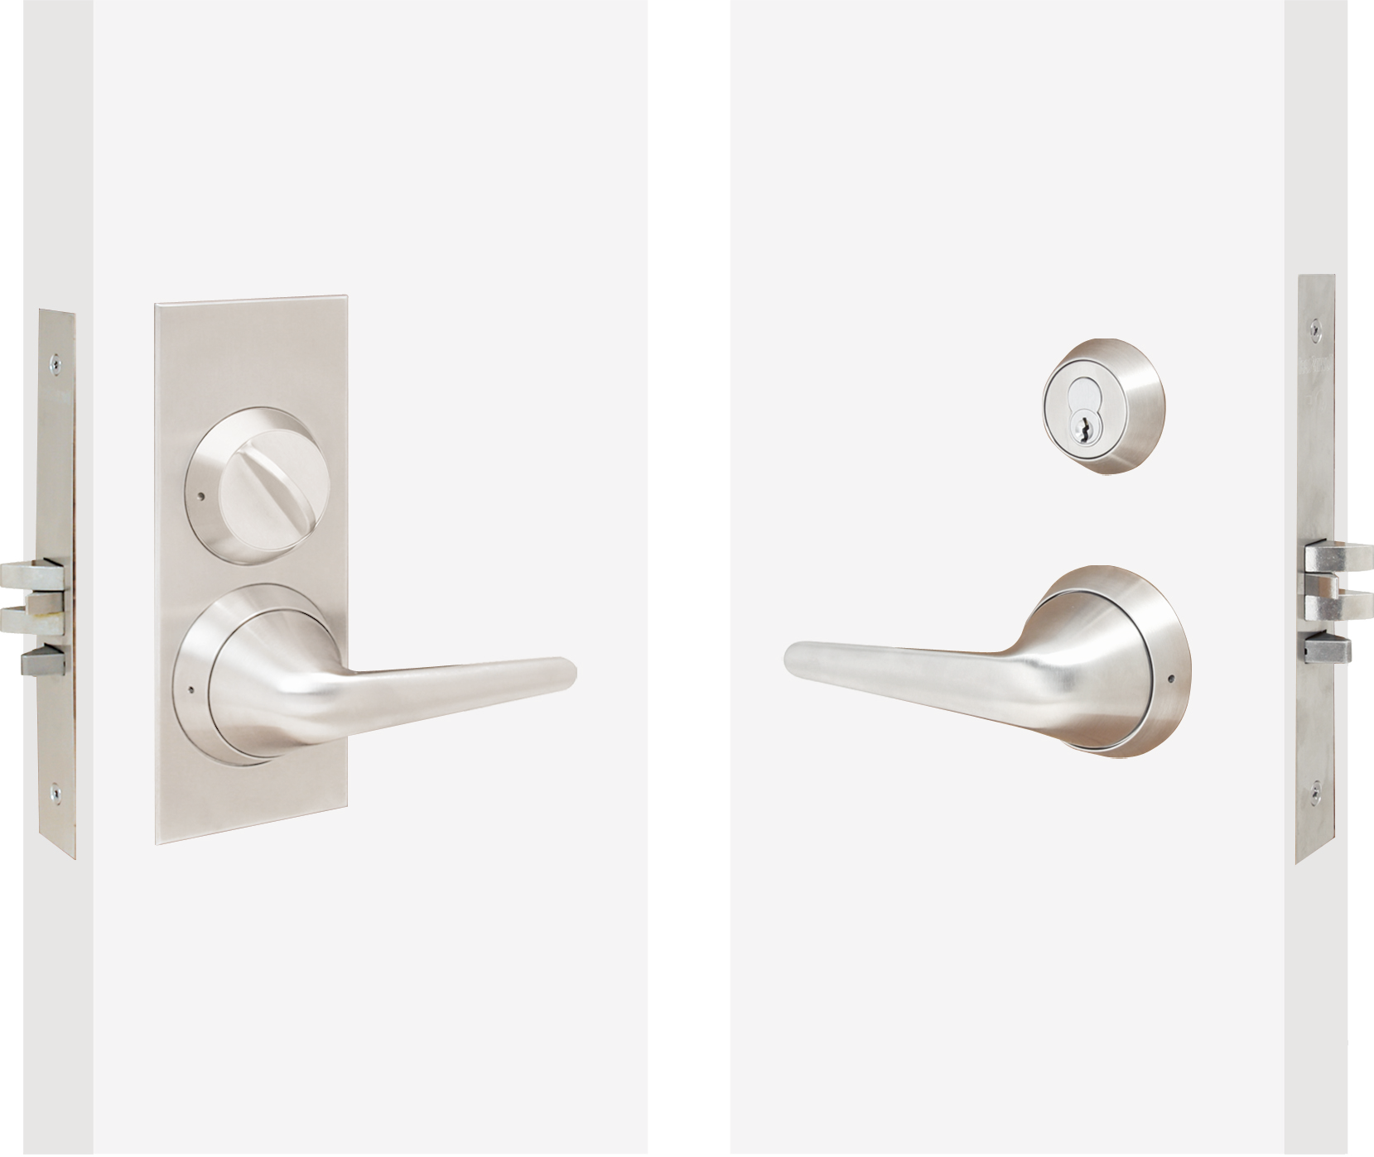
MRX-L Ligature Resistant
Mortise Lock
Non-clutching Mortise Grade 1, UL listed for a 3-hour fire door
1 ¾” thick doors- can accommodate different thicknesses
2 ¾” backset only
Tamper resistant screws for mounting
Compatible with standard mortise cylinder and various IC cores using the TS cam
Units are non-handed
Uses the clutching mortise
Sectional (MRX-S-L) and Escutcheon (MRX-E-L)
Allen wrench to secure outside lever
Can handle all standard mortise functions
Find this product at townsteel.com/products/mrx-l/

Slide 22
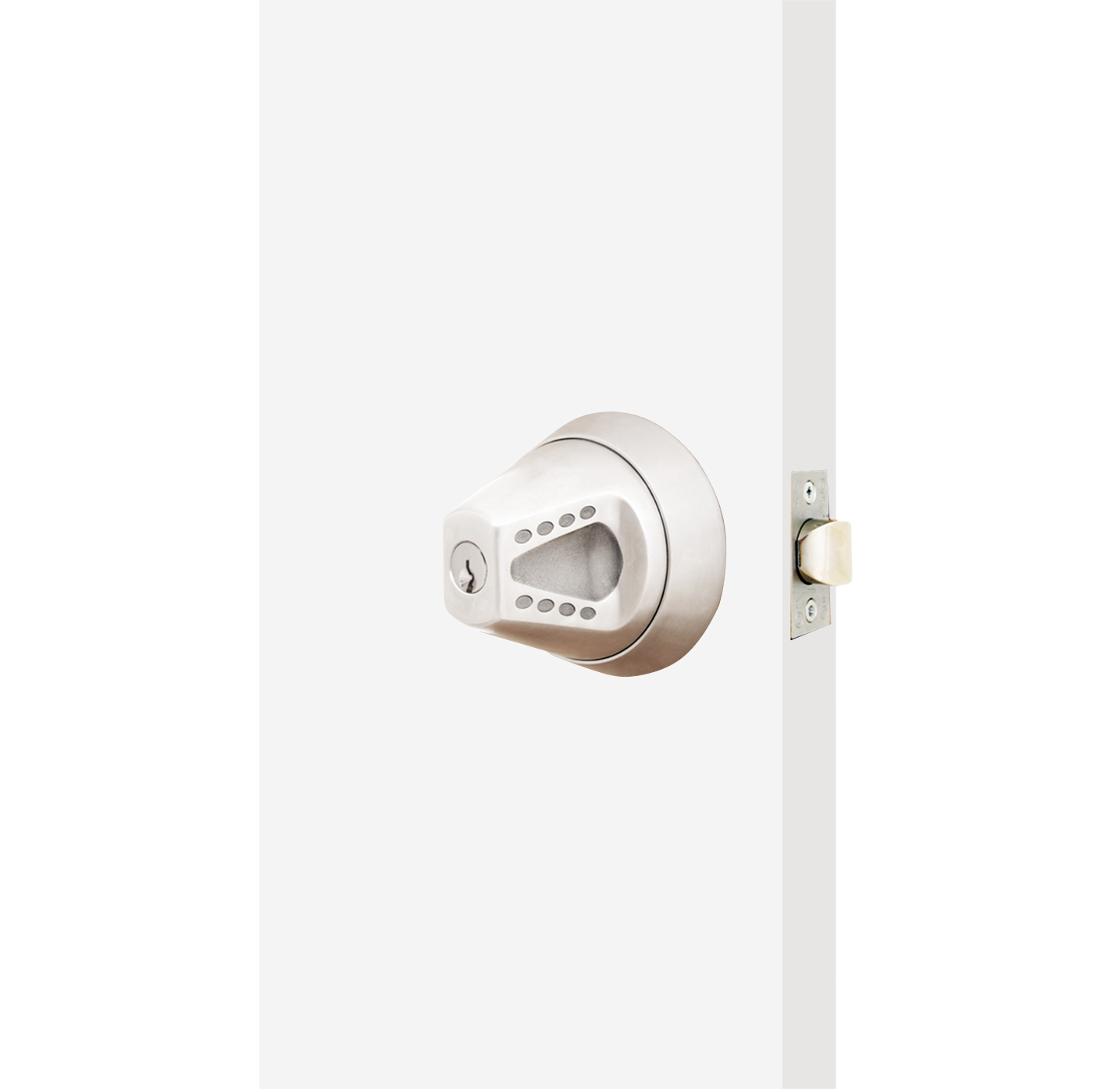
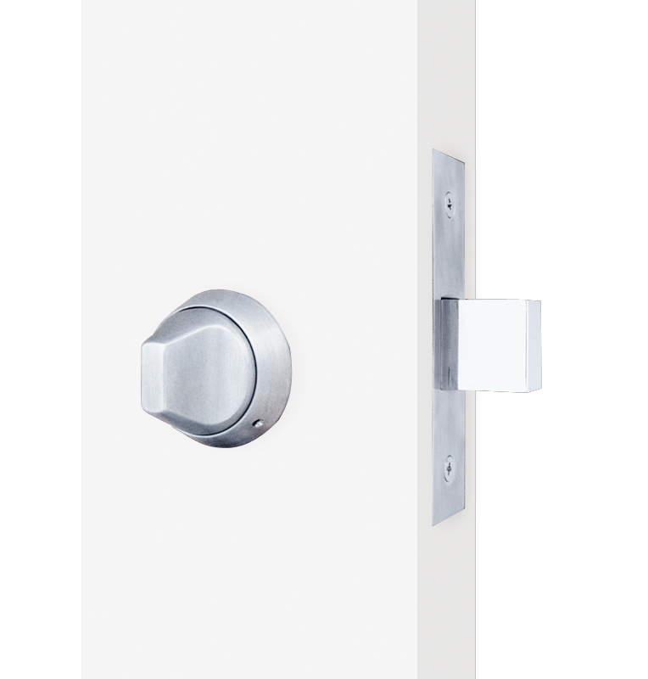
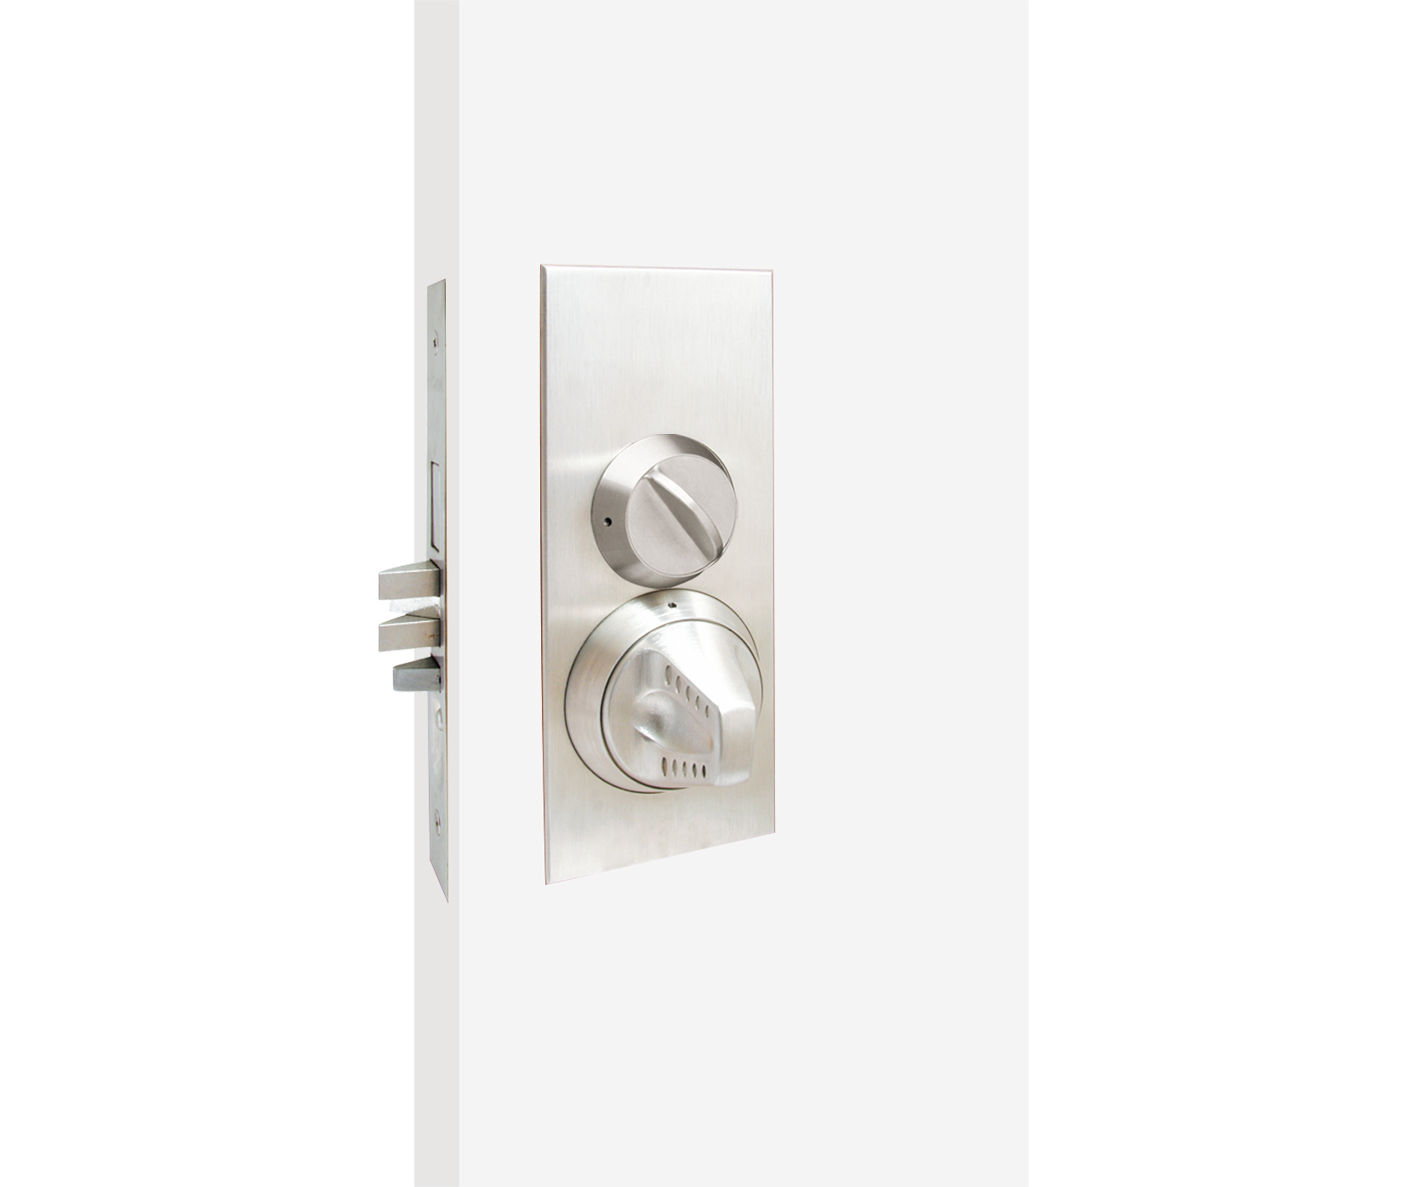
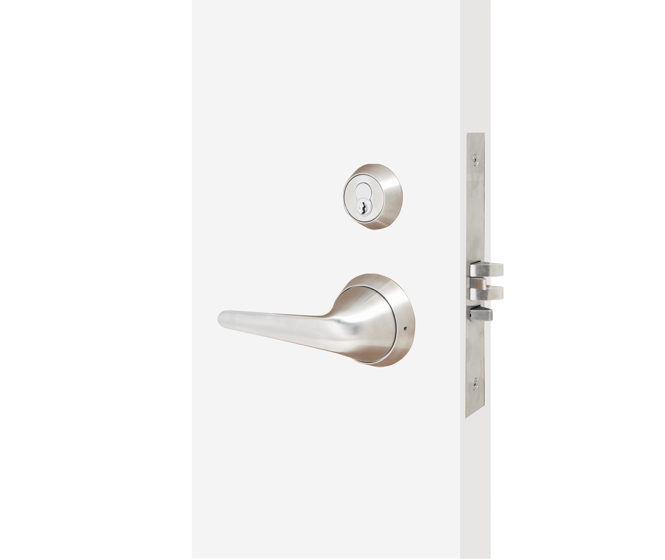
Ligature Resistant Levers and Knobs
CRX-K
TRX-L
DRX
MRX-E-K
MRX-L

Slide 26
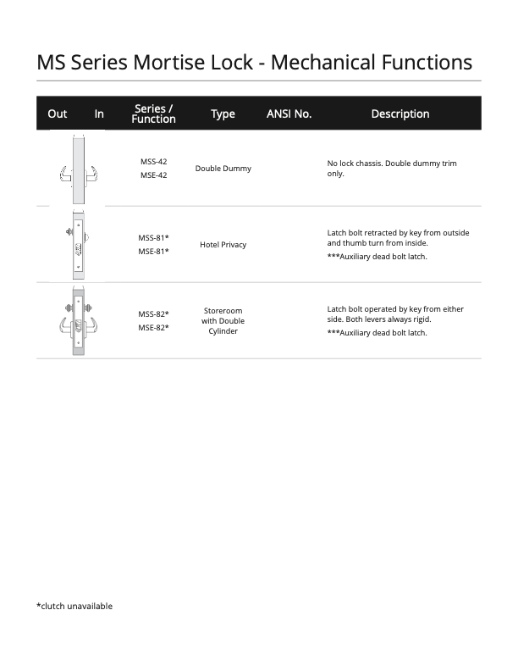

Slide 28
[Name]
[Phone Number]
[Email]

