Slide 1
HubSpot Mobile App Business Card Scanning

Slide 2
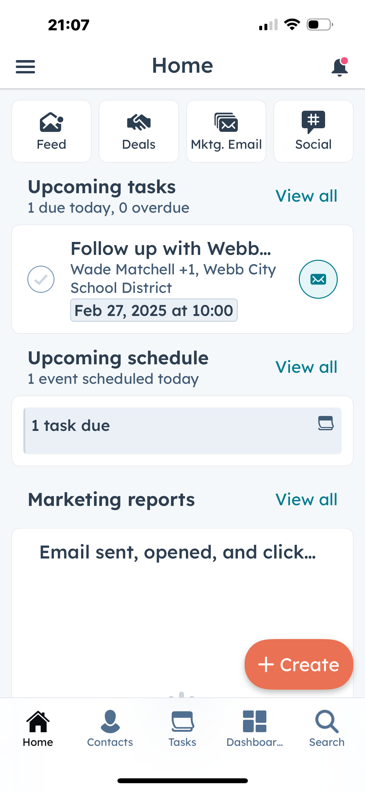
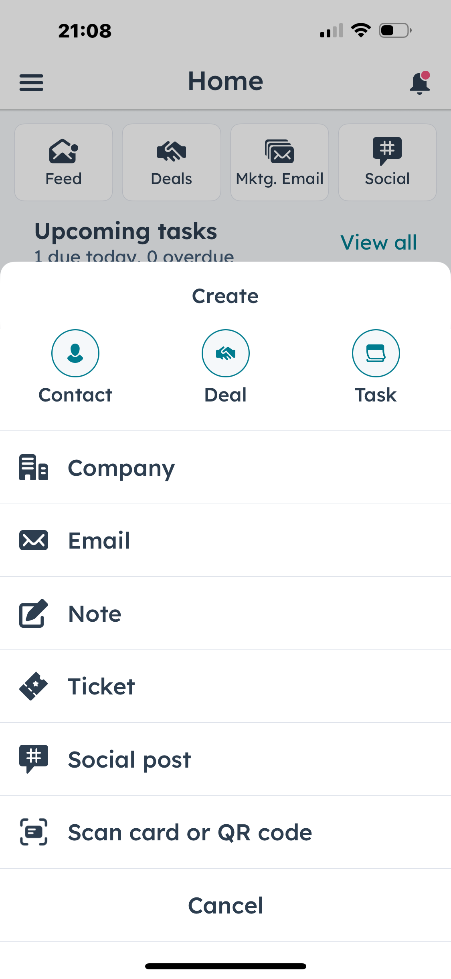
You can create a contact by simply scanning their business card

Slide 3
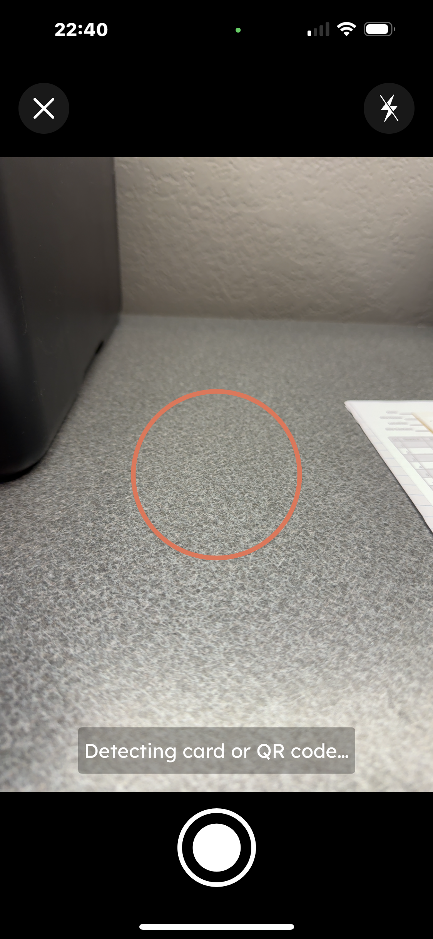
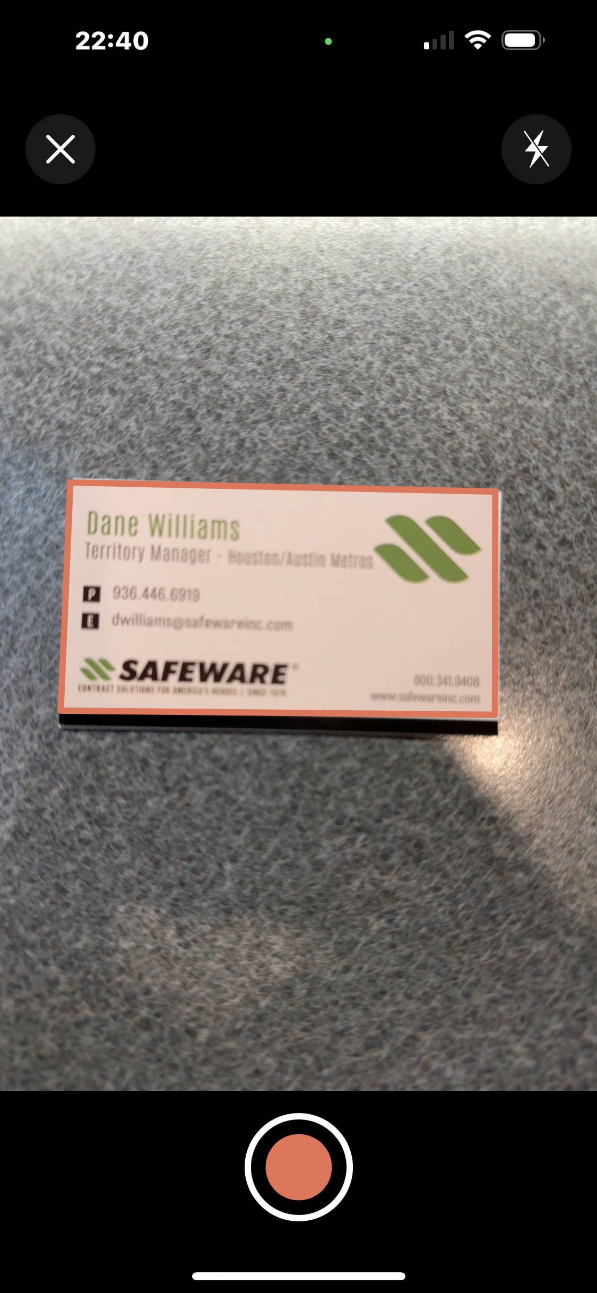
Once it senses a card, it will outline it in red, signifying its ready for you to snap the picture
Camera and app starts looking for card or QR code to scan

Slide 4
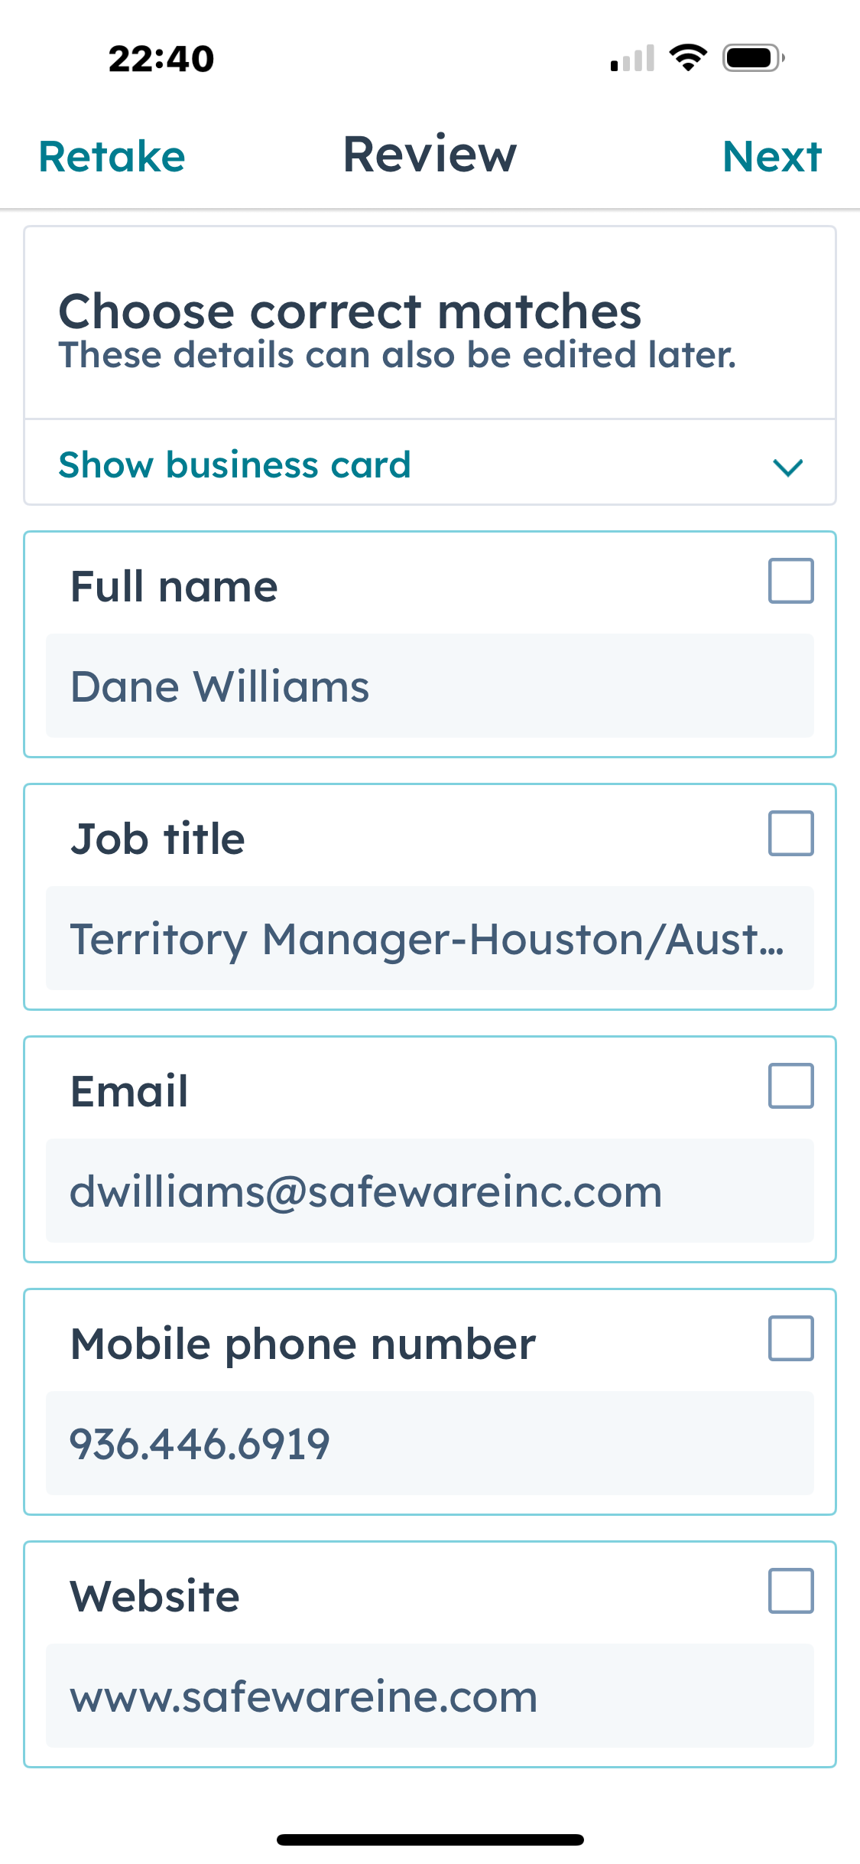
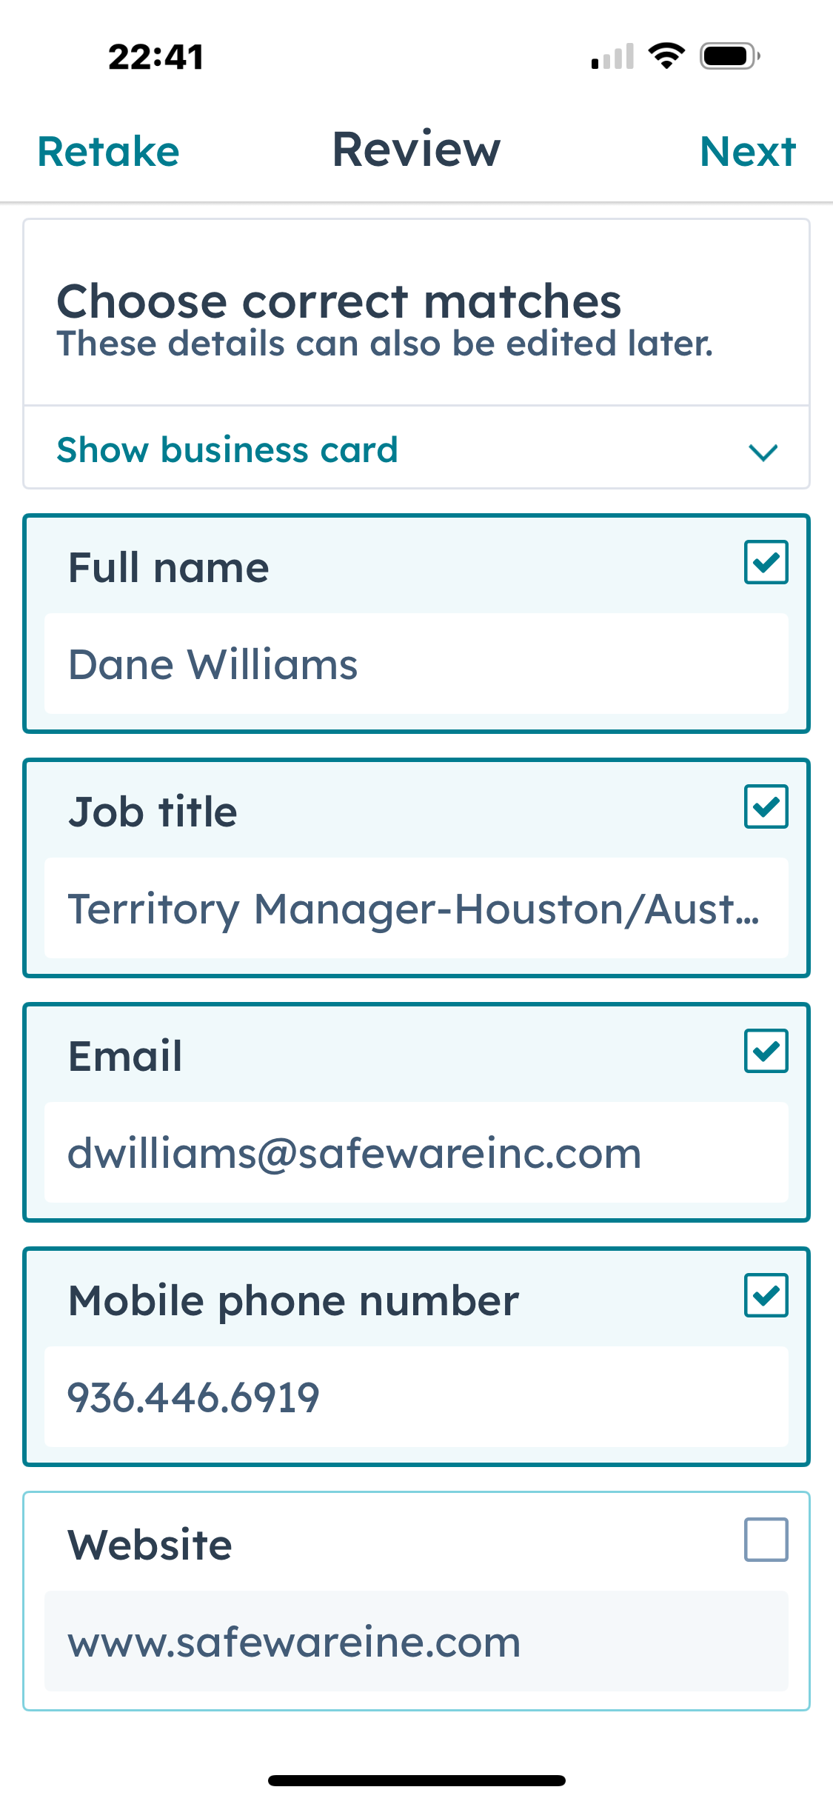
The app will fill in info it analyzes and place it in what it thinks is the correct data field. Make sure you check accuracy.
Select all the correct fields you want the app to fill into HubSpot contact
Leave this one unselected for manual entry next
It misread the website URL

Slide 5
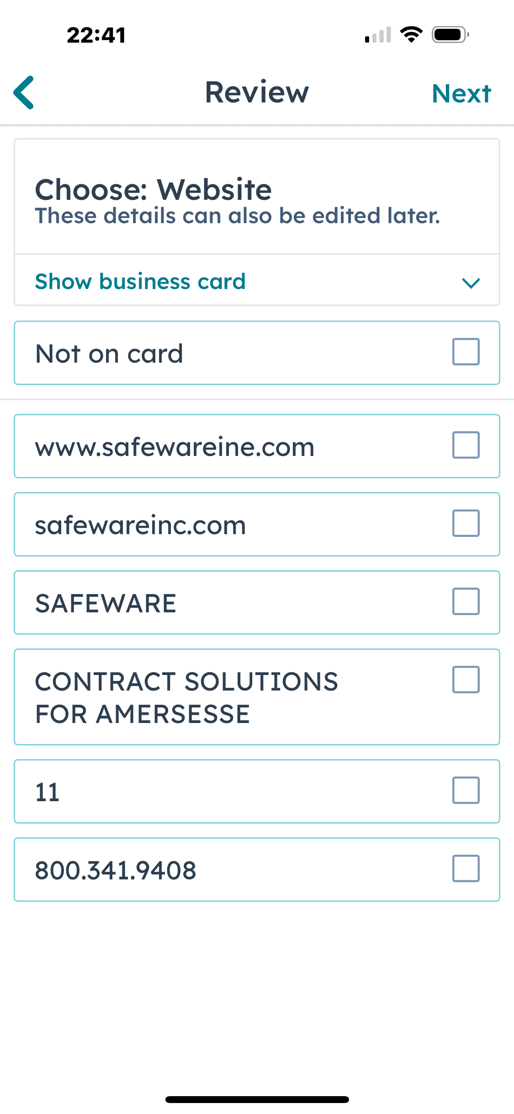
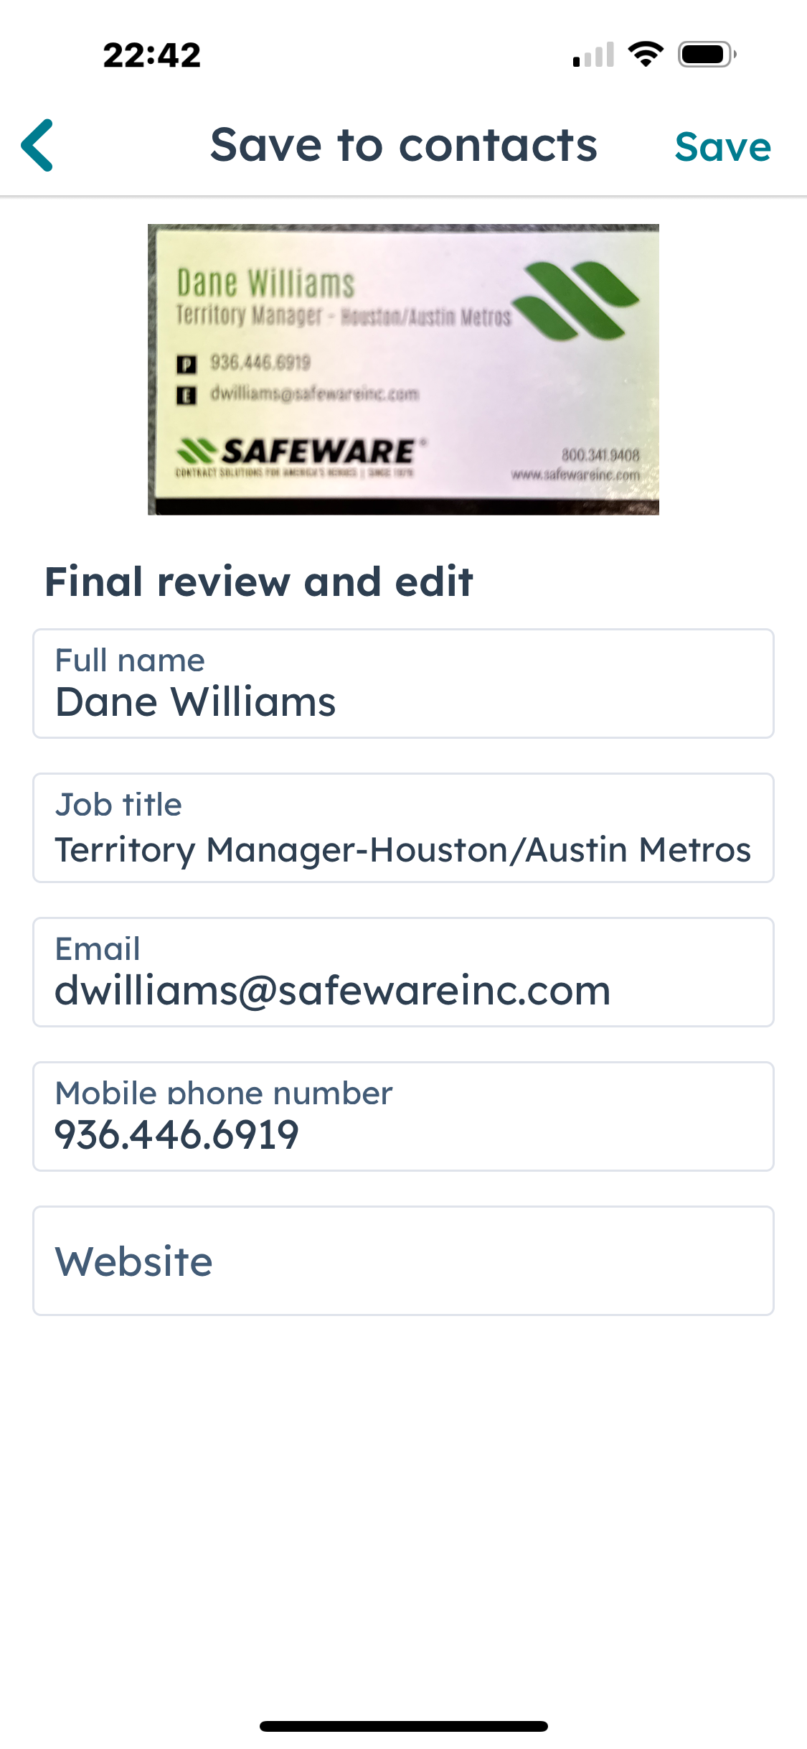
See if any of these options are the correct website, if not, select “Not on card” for manual entry, then hit “Next”
Manually enter the correct web address, then hit “Save”

Slide 6
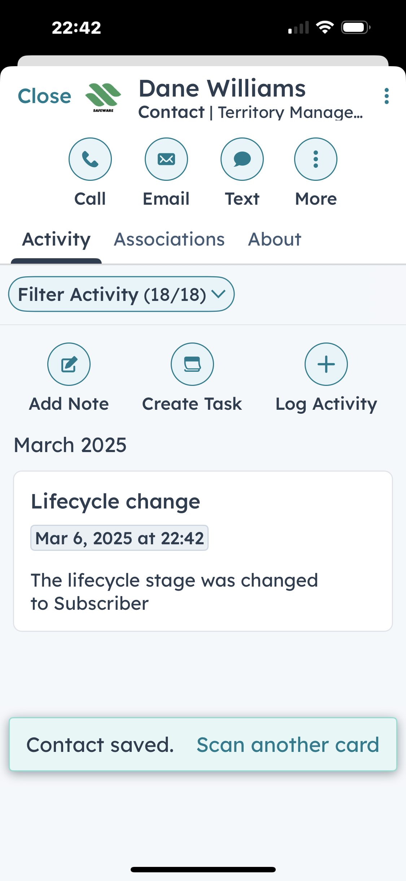
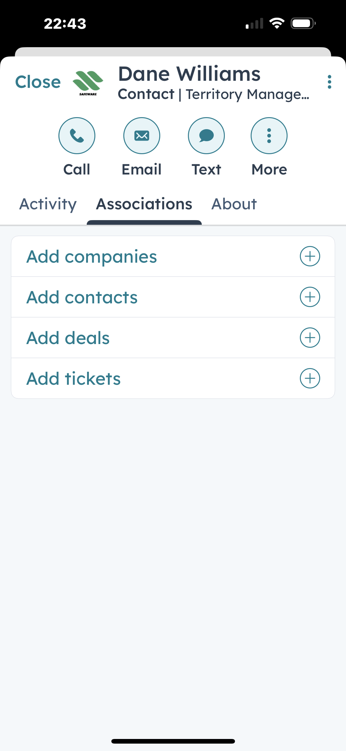
Completed contact entry
To add the associated company, select “Associations”
Select “Add companies”

Slide 7
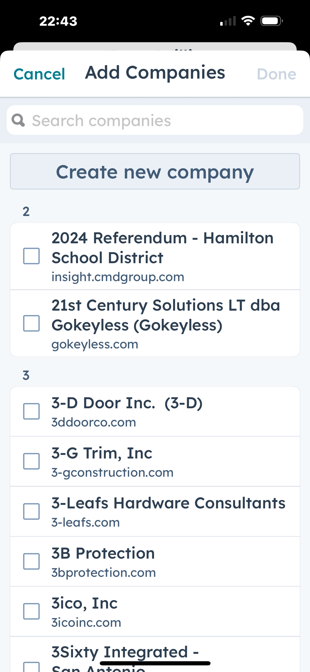
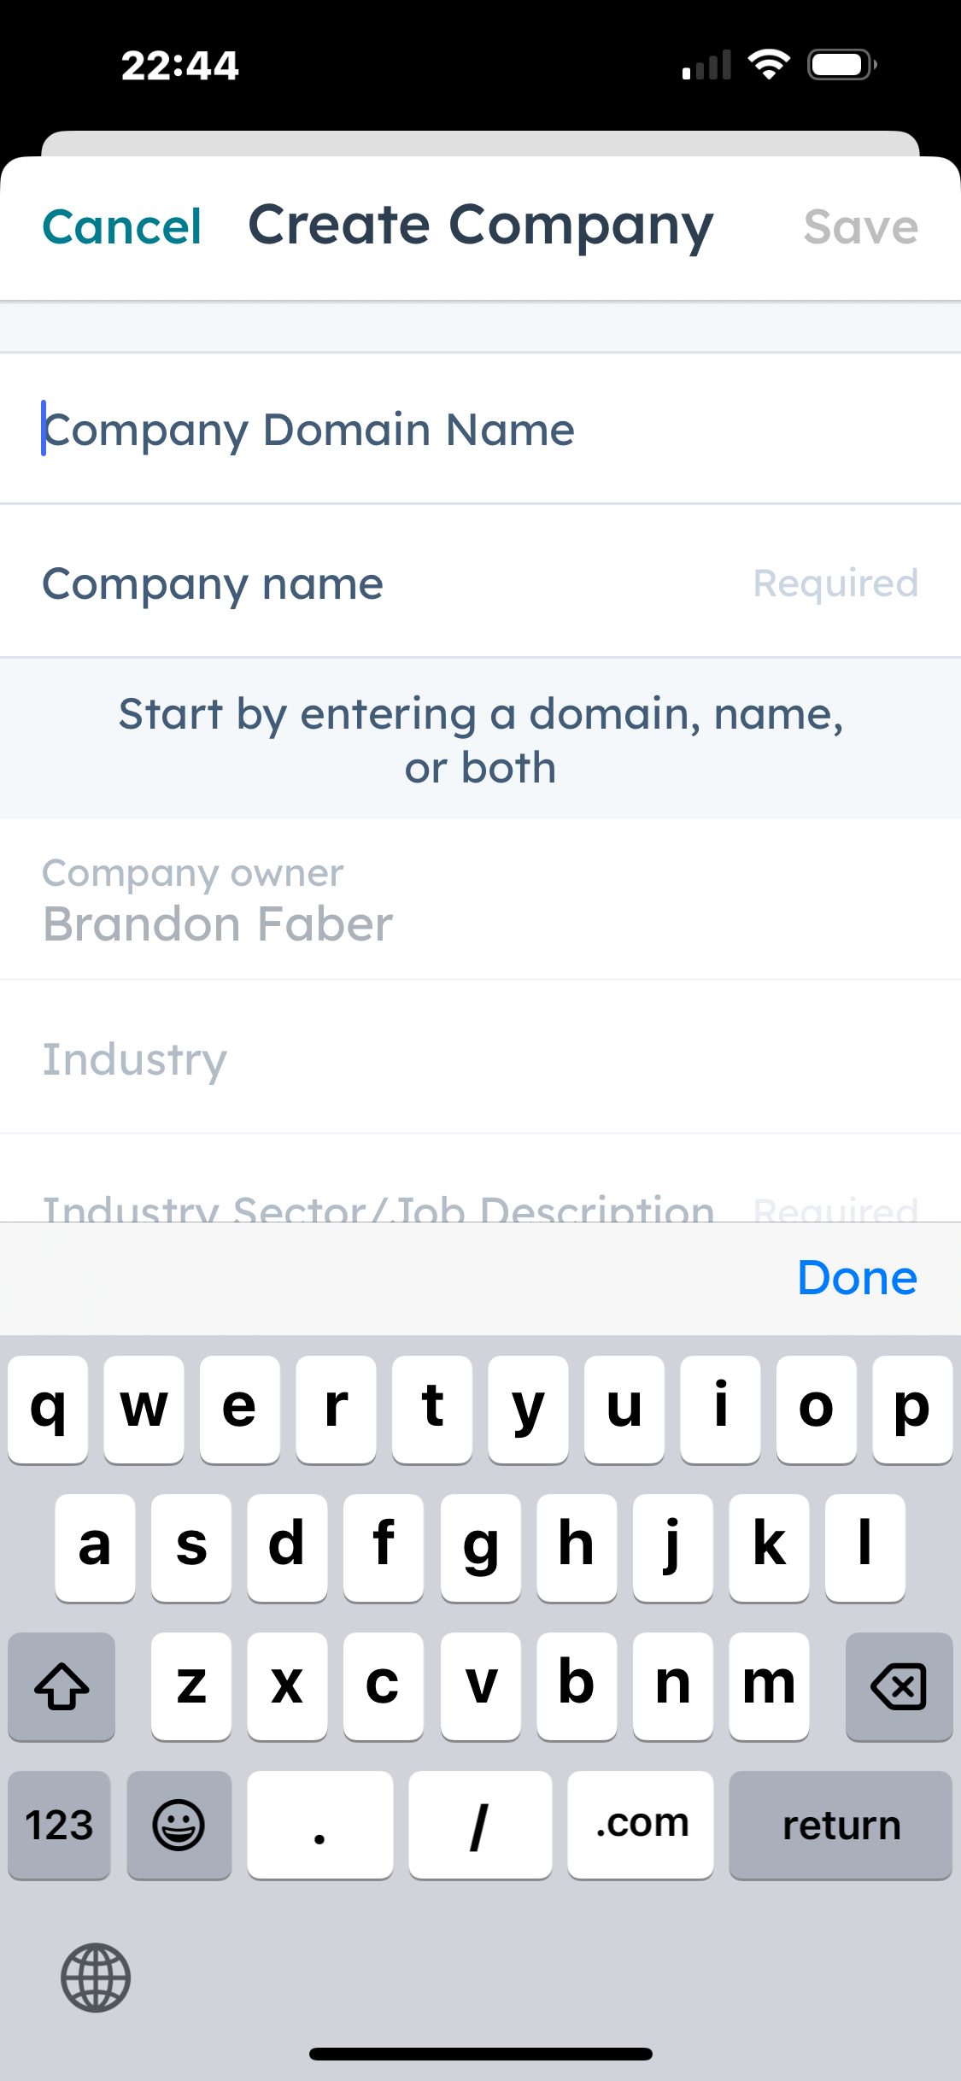
If you know the company exists, or you want to check to see if it does, start typing the company name here and select it to associate
Enter all the company information you have, then hit “Save” to associate it to the contact you entered via the business card scanner
If you know it doesn’t exist, click here to manually enter it

