Slide 1

TownSteel Product Introduction
November 15, 2023
Luis Ramos
Luis@townsteel.com
323-424-0989
Notes:
We designed this template so that each member of the project team has a set of slides with its own theme. Members, here’s how you add a new slide to just your set:
Mark where you want to add the slide: Select an existing one in the Thumbnails pane, click the New Slide button, then choose a layout. The new slide gets the same theme as the other slides in your set.
Careful! Don’t annoy your fellow presenters by accidentally changing their themes. That can happen if you choose a different theme from the Design tab, which changes all of the slides in the presentation to that look.

Slide 2
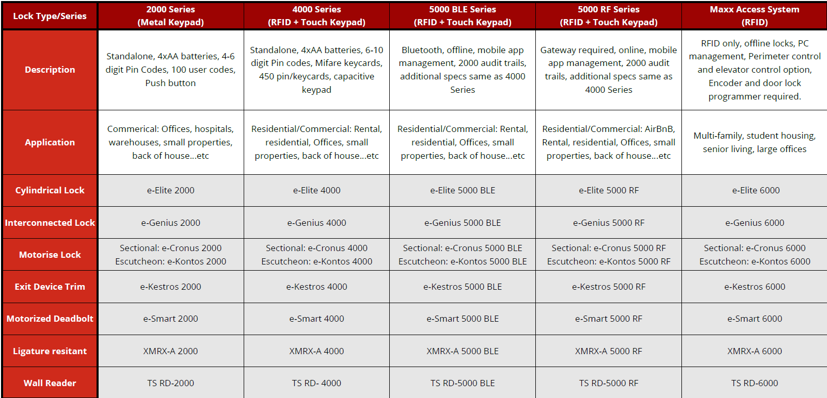
TownSteel Product Tree
Mortise Lock

Slide 3
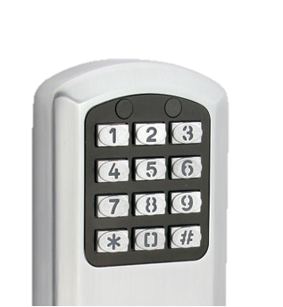
2000 Series – Metal Keypad
1 master code, 100 user codes, 5 service codes (one-time use)
12-key illuminated metal keypad
Lab tested two-year battery life
Non-volatile memory
Weather resistant
-32 F to 145 f
Passage mode
Pass through duration
Programmable at keypad only
Recommended 1-10 locks

Slide 4
TownSteel Product Tree
Mortise Lock

Slide 5
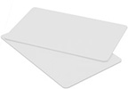
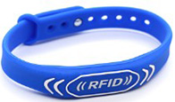

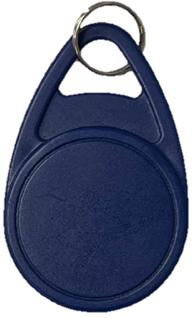

MIFARE RFID Keycards
MIFARE® MF1ICS50 ISO/IEC 14443 Type-A.
Operating frequency: 13.56 MHz
Data transfer: 106 kbit/s
Data integrity: 16-Bit CRC, parity, bit coding, bit counting
1 kB and 4 kB, organized in 16 sectors with 4 blocks of 16 bytes each
Data retention of 10 years
Write endurance 100.000 - 200.000 cycles

Slide 6
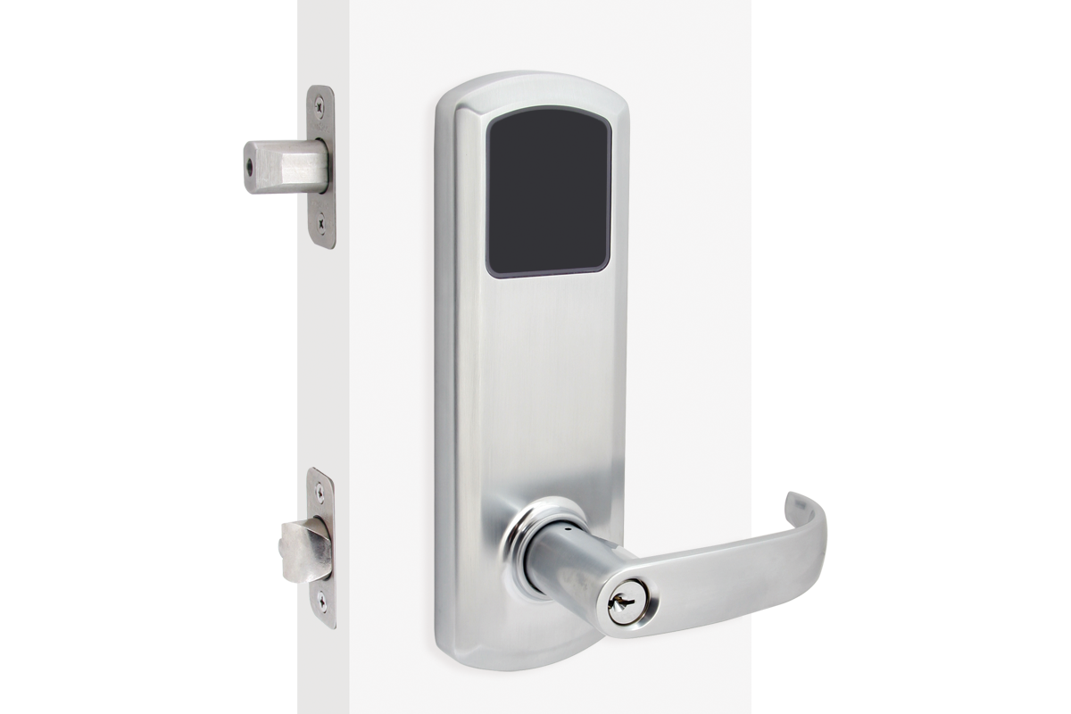
4000 Series –Touch pad
1 master code, 447 user codes/keycards, 1 passage mode keycard or pin code
12-key illuminated touch pad
Lab tested two-year battery life
Non-volatile memory
Weather resistant
-32 F to 145 F
Passage mode
Programmable at keypad only
Recommended 1-10 locks

Slide 7
TownSteel Product Tree
Mortise Lock

Slide 8
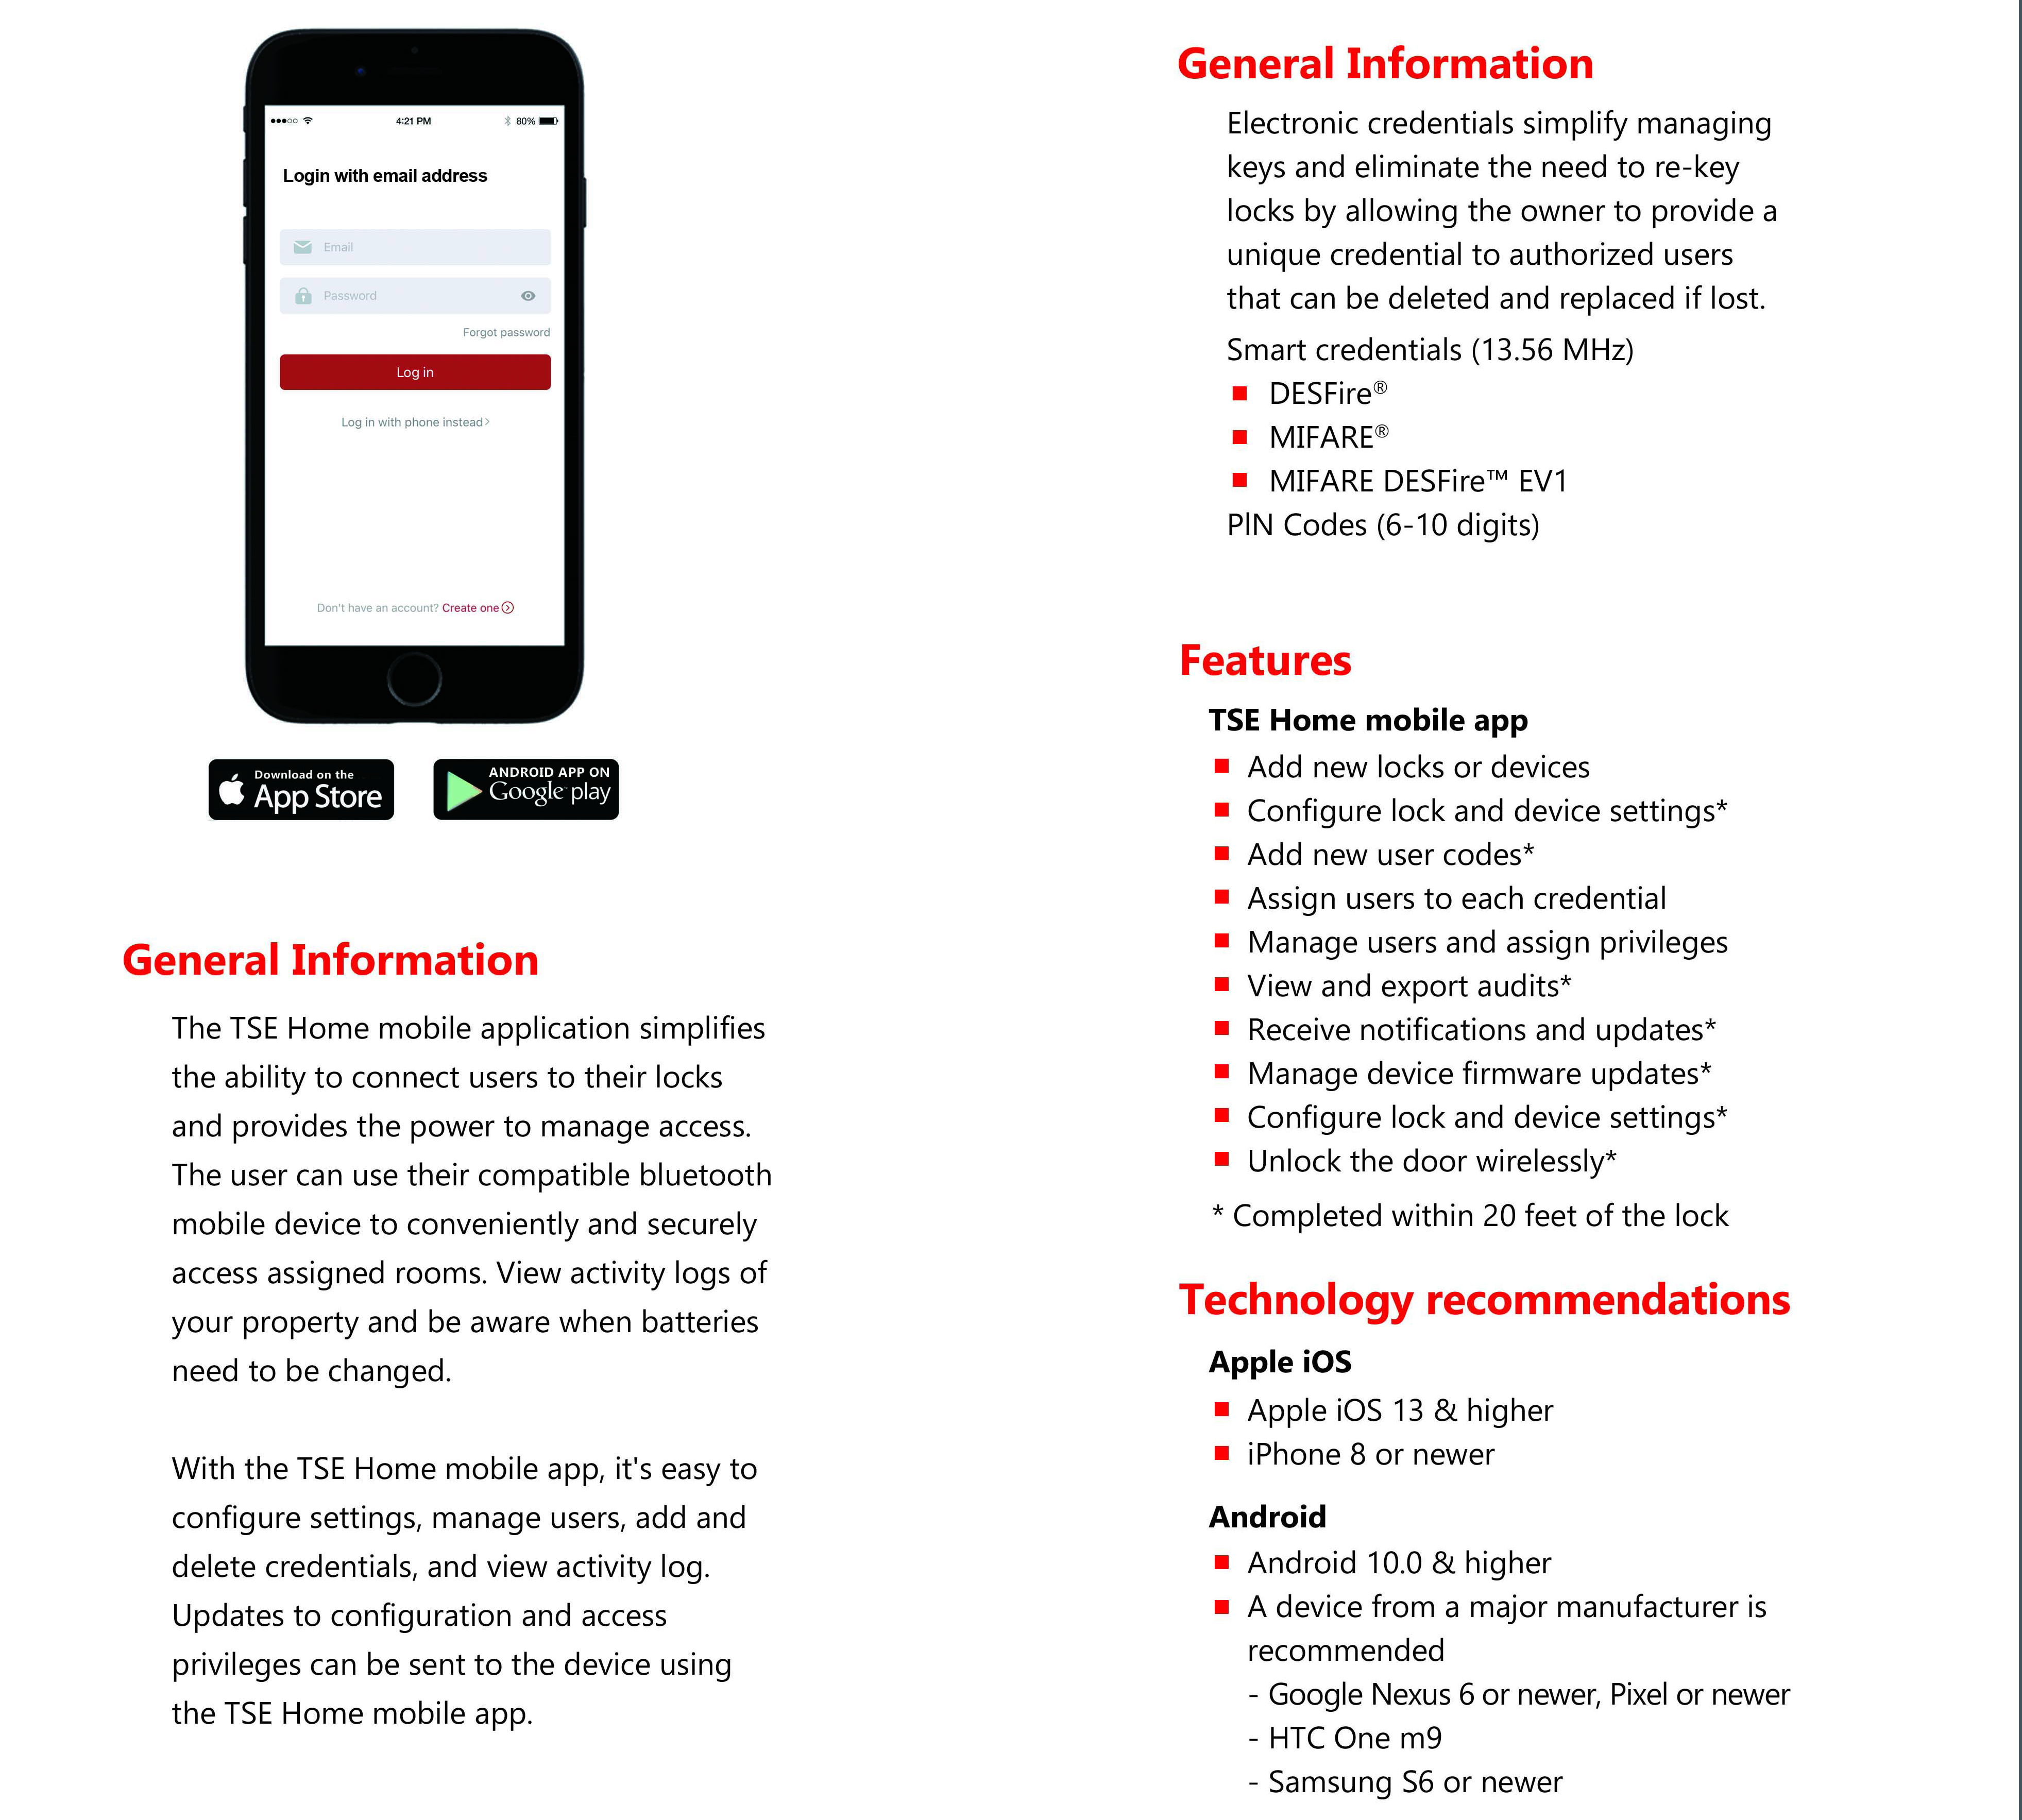
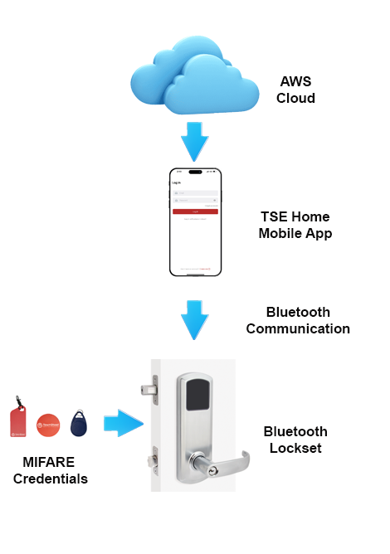
5000BLE Series – Mobile App
Notes:
• Easy, affordable upgrade from mechanical locks • Allows users to manage locks locally • Fast, simple installation • Flexibility to add and remove users without issuing keys

Slide 9
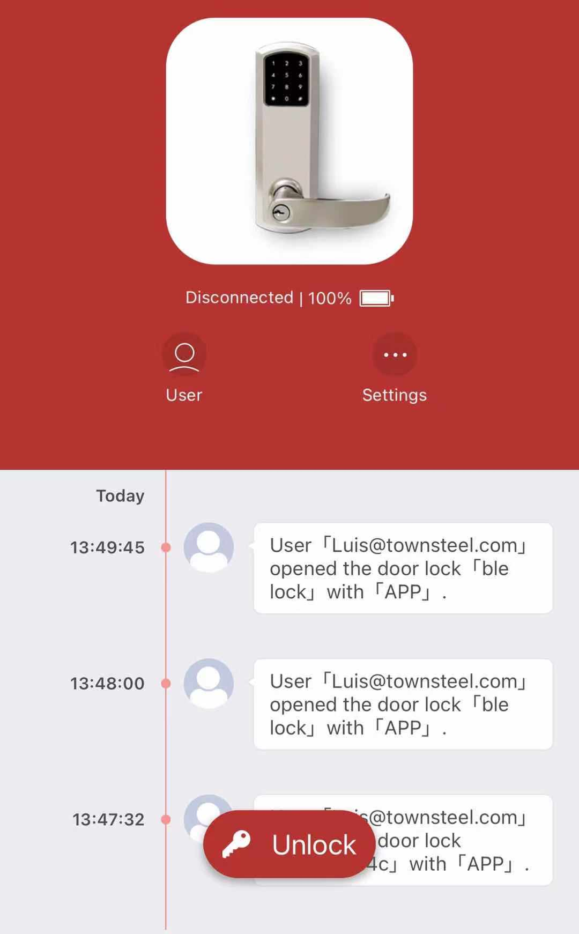
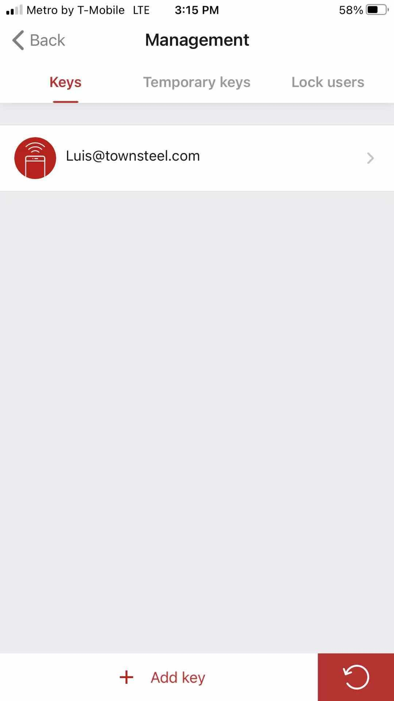
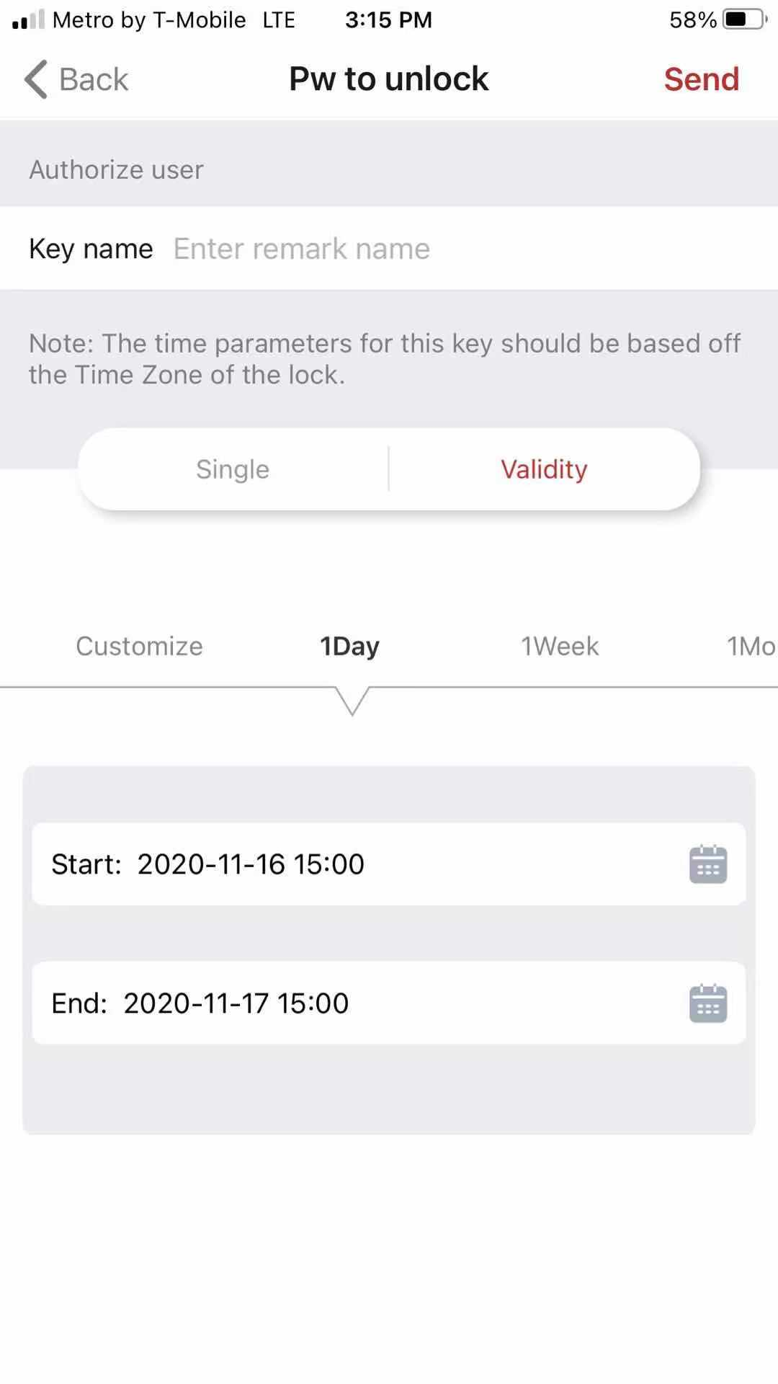
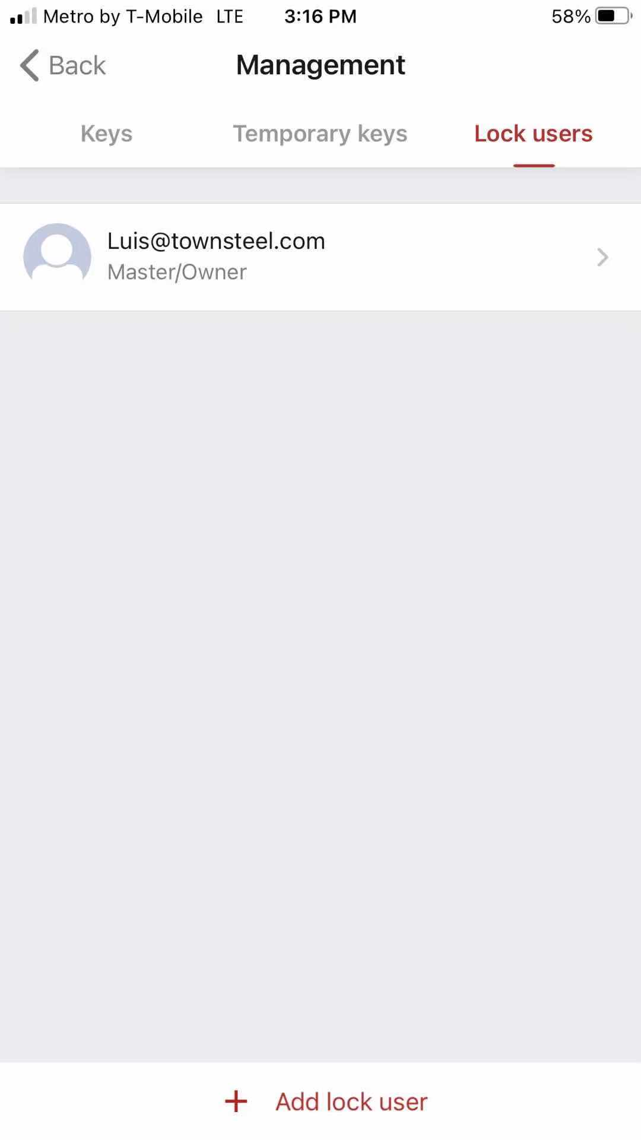
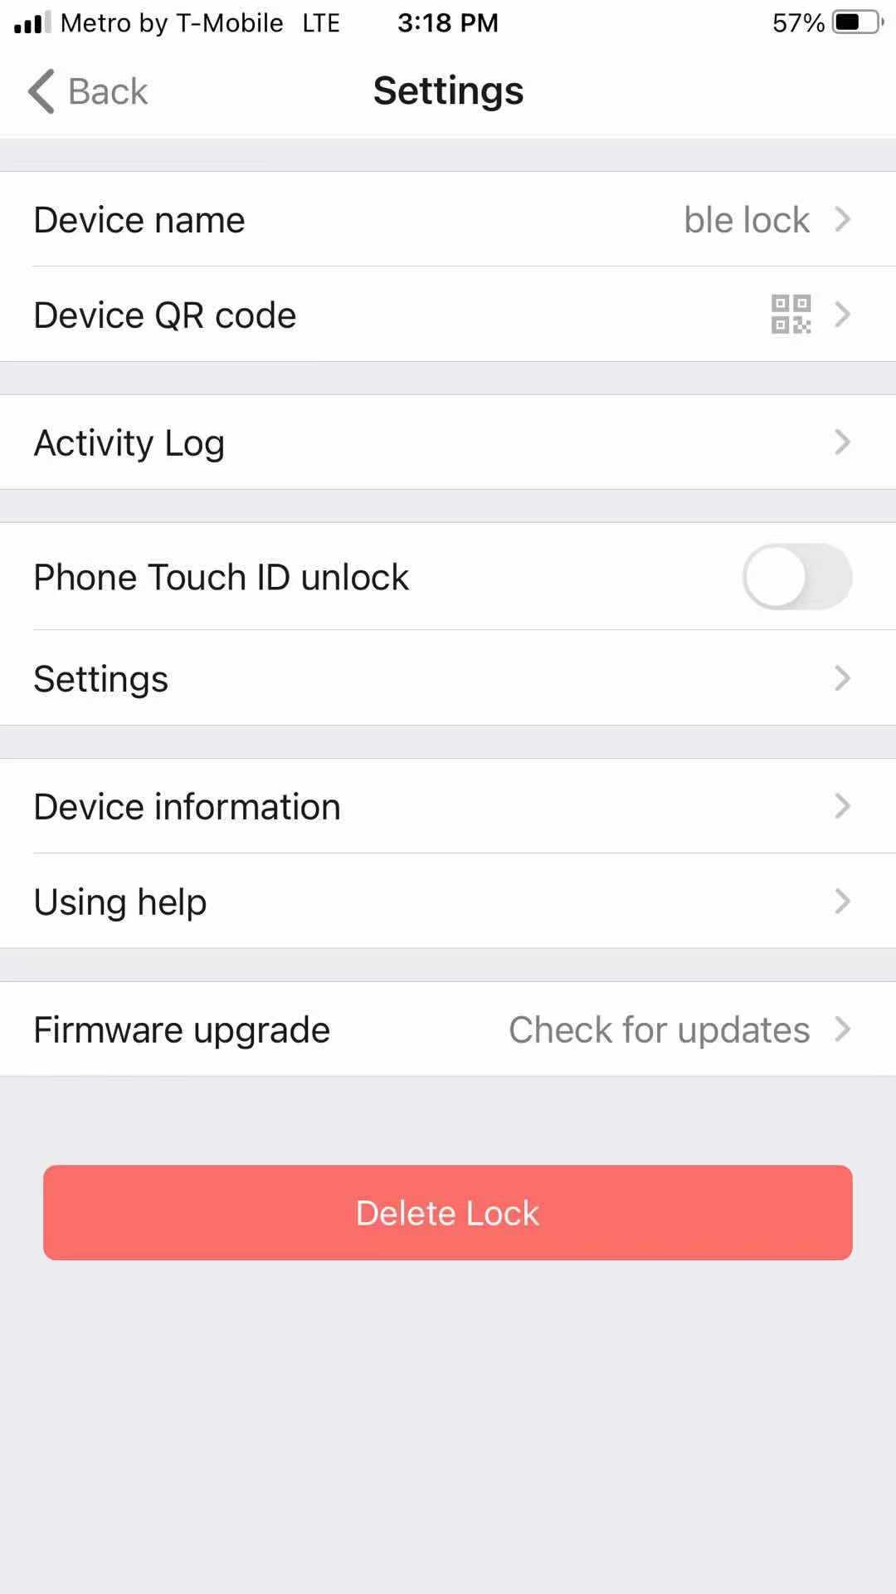
5000 Series – BLE Mobile App

Slide 10
TownSteel Product Tree
Mortise Lock

Slide 11
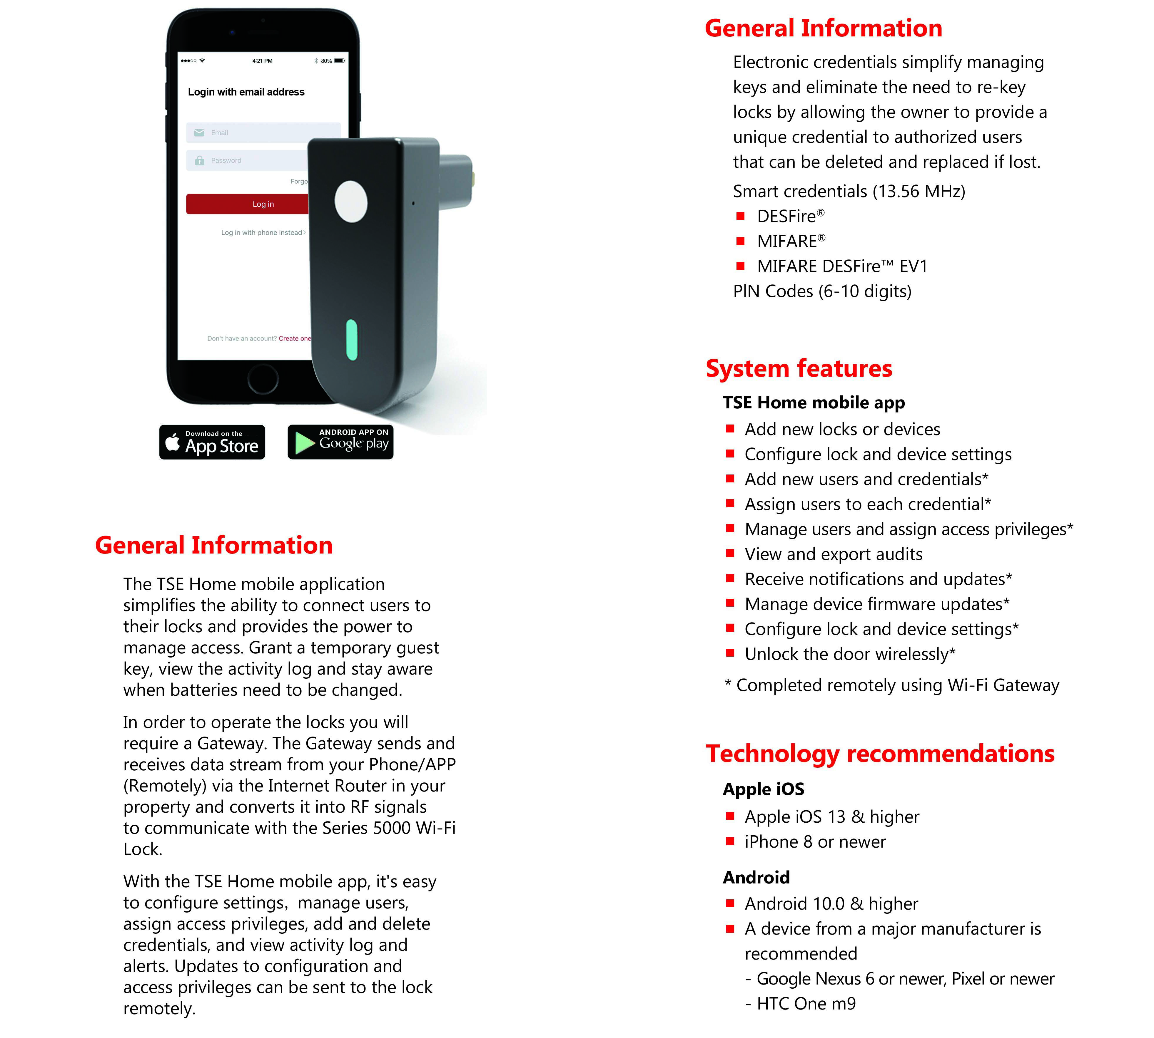
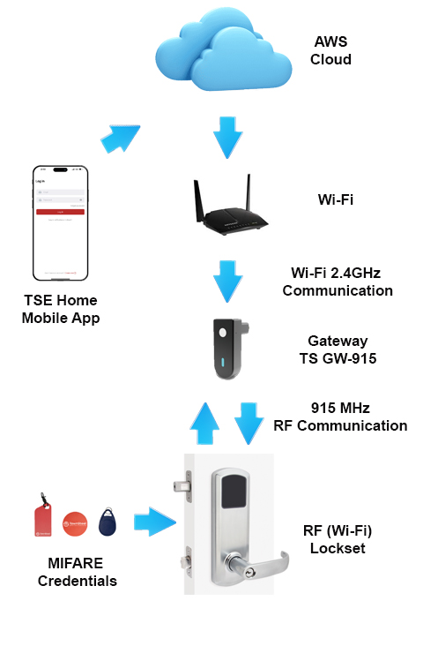
5000RF Series – Wi-Fi Mobile App
Notes:
Advanced data security with standard encryption techniques • AES 128-bit encryption Real-time communication to the access control system for greater security and control
APPLICATIONS
• Classrooms
• Record rooms
• Offices
• Residence halls

Slide 12
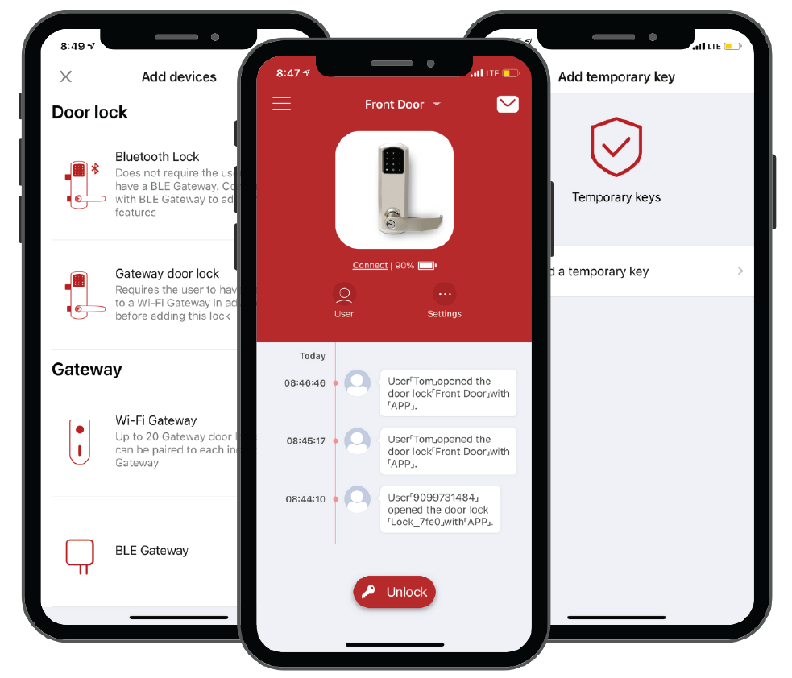
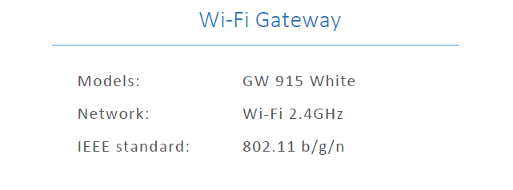
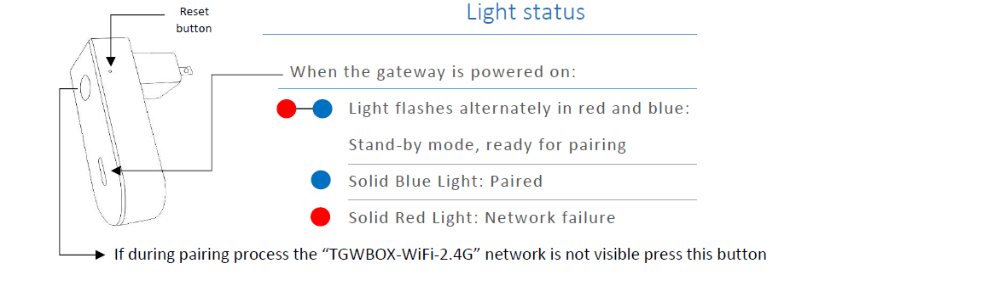
Wi-Fi Gateway

Slide 13
TownSteel Product Tree
Mortise Lock

Slide 14
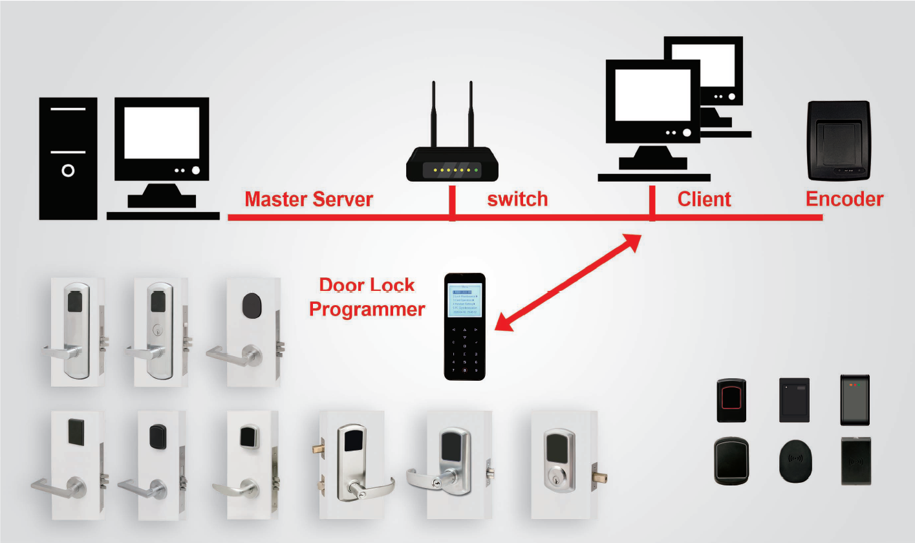
Maxx Access Management
System
Unlimited encoding stations
Encrypted MIFARE credentials
AC/EC module
Multiple User profiles
Use standard batteries for easy deployment and maintenance
Locks support 2000 events
Programming is accomplished through the use of a DLP and PC-based software
Up to 1,622,016 openings supported

Slide 15
MIFARE RFID Keycards
MIFARE® MF1ICS50 ISO/IEC 14443 Type-A.
Operating frequency: 13.56 MHz
Data transfer: 106 kbit/s
Data integrity: 16-Bit CRC, parity, bit coding, bit counting
1 kB and 4 kB, organized in 16 sectors with 4 blocks of 16 bytes each
Data retention of 10 years
Write endurance 100.000 - 200.000 cycles

Slide 16
AegisSecure

Slide 17
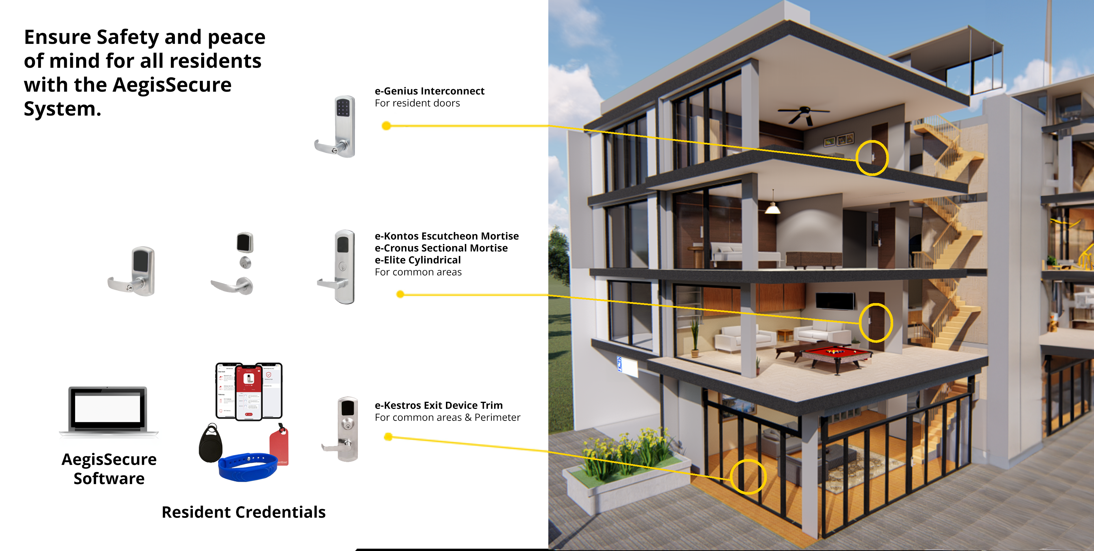
AegisSecure
Multi-Housing

Slide 18
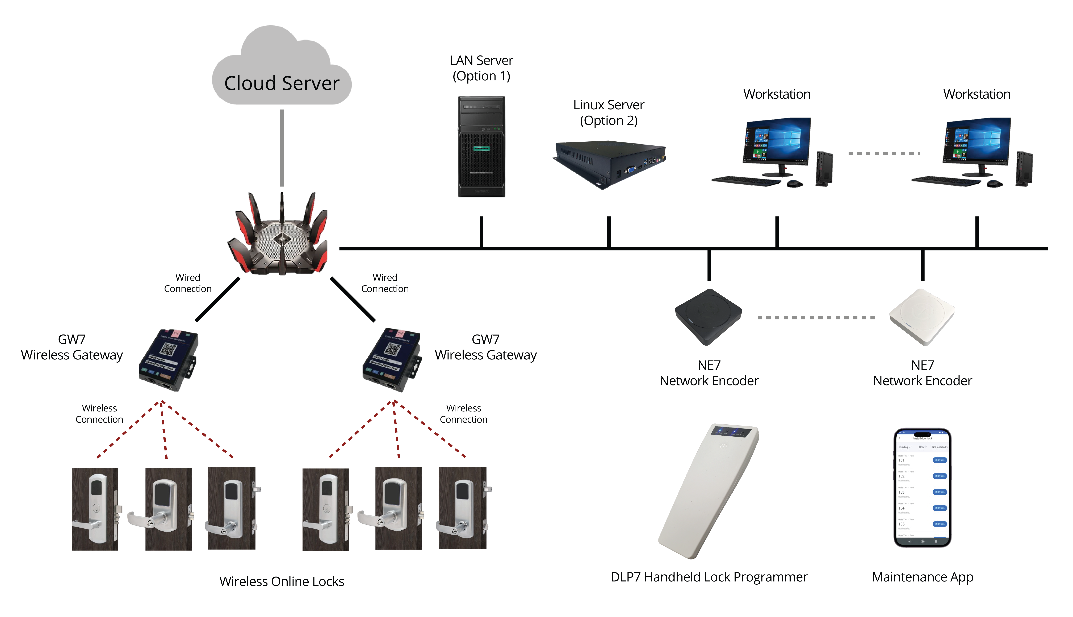
System Deployment Framework

Slide 19
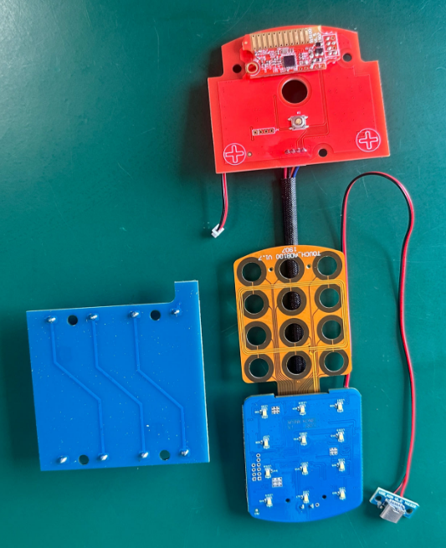
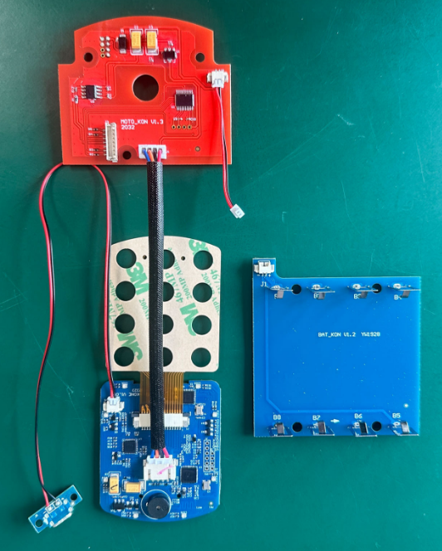
Wireless online door lock
KONTOS 7000
Unlock methods: Keycard, Pin code, App, Remote unlock
Key quantity: 889
Battery lifetime: 12 months
Security encryption: AES128+MD5+DES and other multi-encryption methods
Time management: 1)Time-sensitive data on card; 2)Pin code that is valid offline; 3) half-hour one-time Pin code.
Permission control: 1)key replacement function; 2) freeze, enable and delete by user all/single key; 3)master card functionality.
Synchronization function: 1) synchronize the list of keys; 2) synchronize operation records.
Status detection: 1)REX; 2)Privacy; 3)Door position; 4)Battery Life.
Alarm function: 1)Low battery alarm; 2)Sequential Intruder; 3)Wandering Intruder

Slide 20
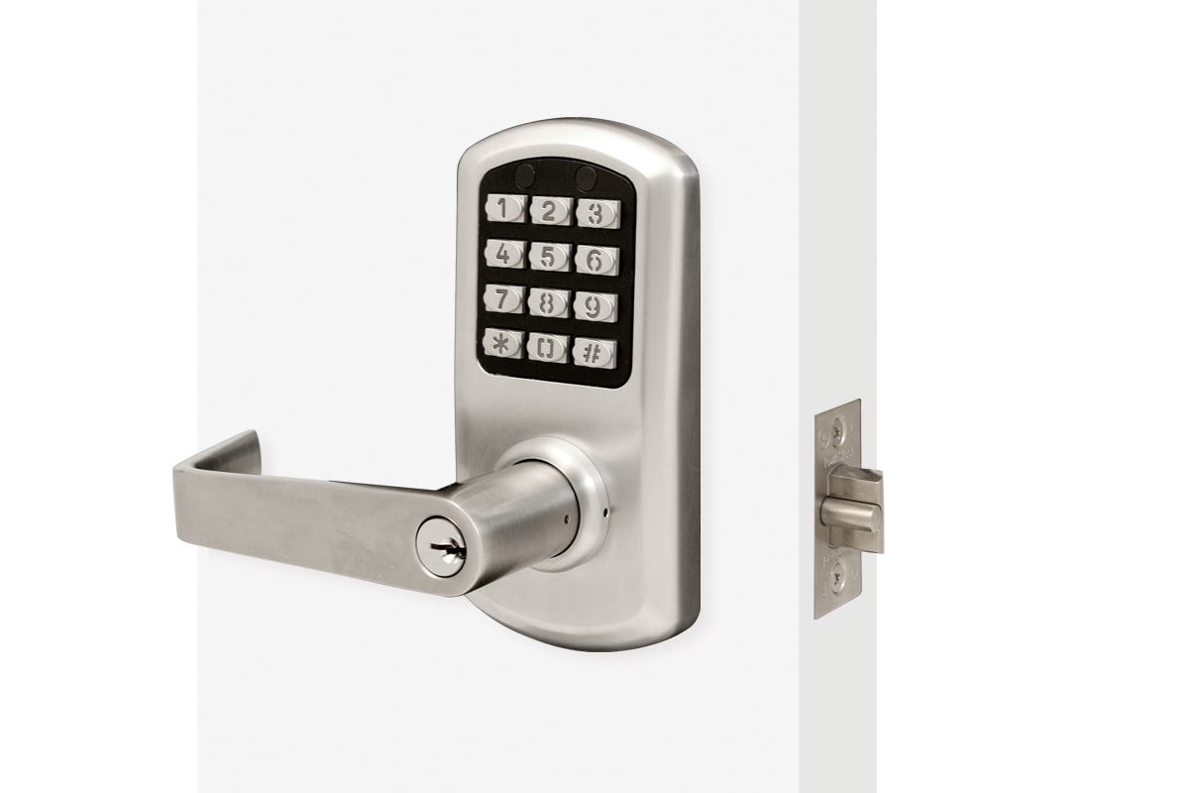
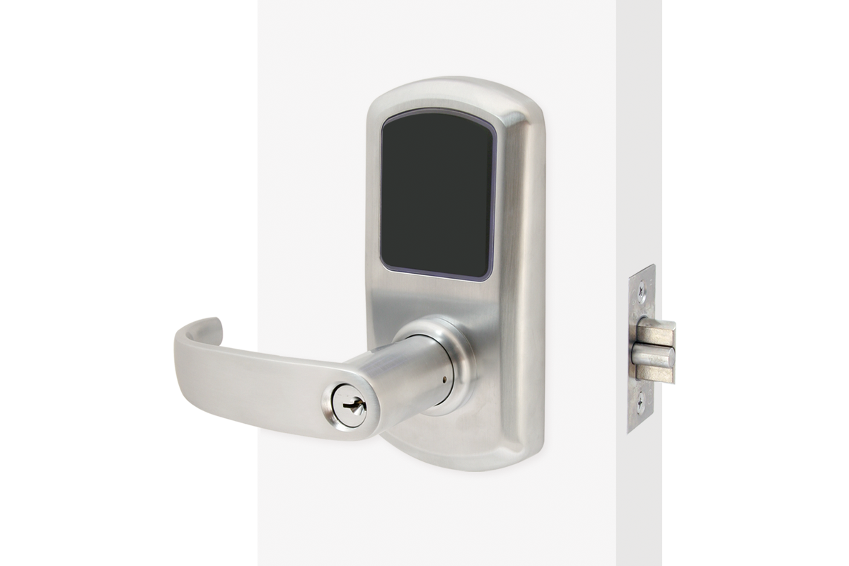
e-Elite Cylindrical Lock
ANSI/BHMA grade 1 security, UL 10C 3 hour rated
Weather resistant lock
Door thickness: 1 3/4”
Backset: 2 3/8” or 2 3/4” or 5”
If you have a stile, it needs to be at least 4.5” for a 2 3/8” backset or 5” for 2 3/4” backset
2000 4000/5000/6000/7000
Notes:
Low profile,
161 door prep
NDE killer, SFIC, LFIC, HS cylinder options,

Slide 21
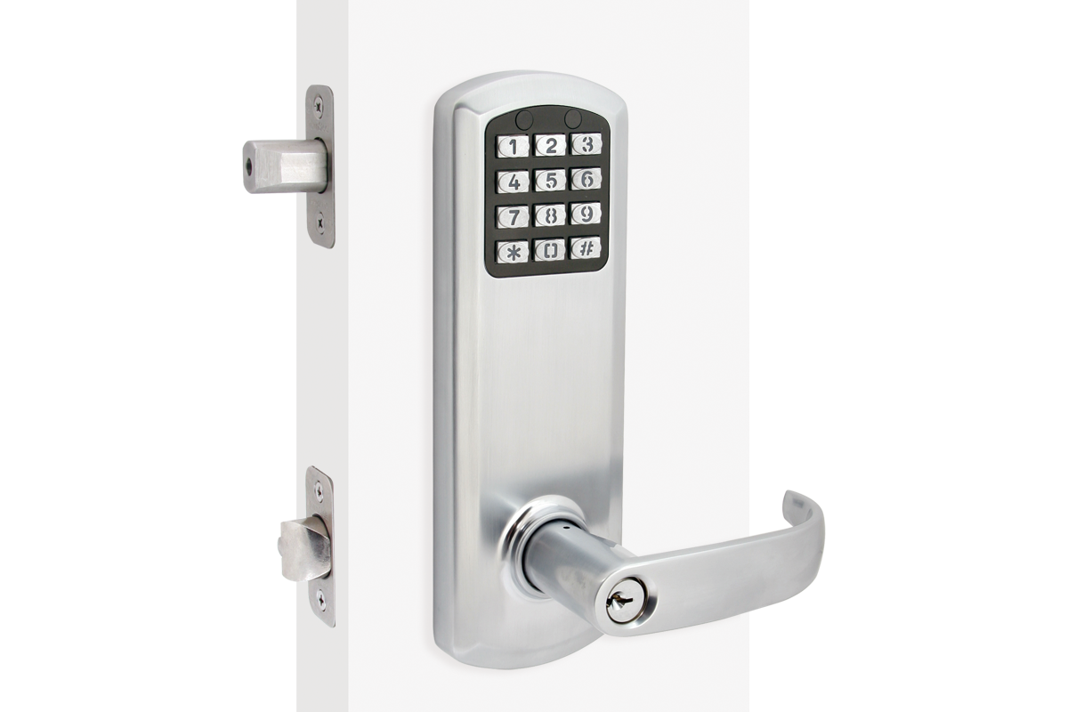
e-Genius Interconnected
Lock
ANSI/BHMA grade 1 security, UL 10C 3 hour rated
Weather resistant lock
Door thickness: 1 3/4”
Backset: 2 3/8” or 2 3/4” (field adjustable)
Requires 4” or 5 1/2” distance from center of dead bolt to center
If you have a stile, it needs to be at least 4 1/2” for a 2 3/8” backset or 5” for 2 3/4” backset
2000 4000/5000/6000/7000
Notes:
3 patents
Dual retract
Lift to lock
Only grade 1 in industry
True residential function
PRI switch - deadbolt

Slide 22
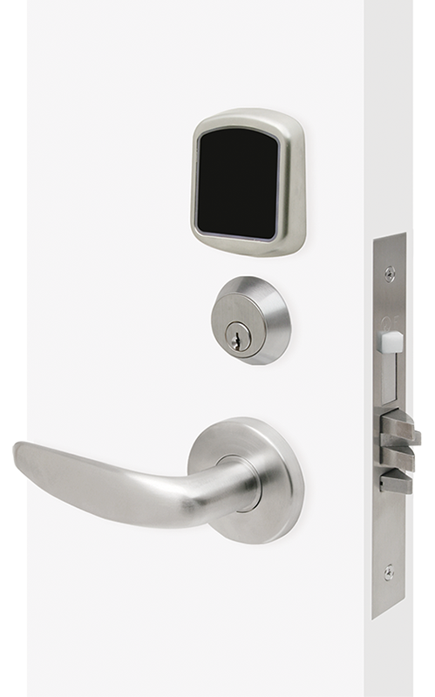
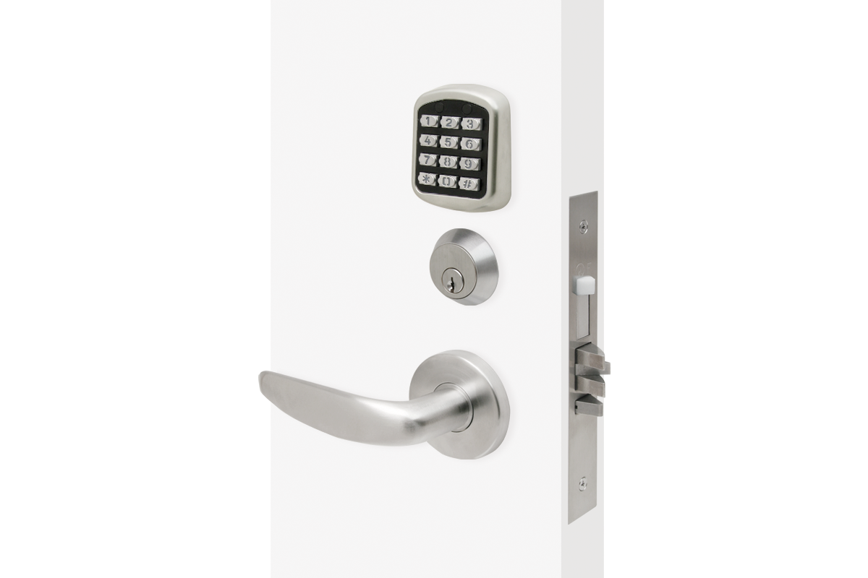
e-Cronus Mortise Lock
ANSI/BHMA grade 1 security, UL 10C 3 hour rated
Rigid, Clutching, or Automatic deadbolt mortise
Weather resistant lock
Door thickness: 1 3/4”
Backset: 2 3/4”
Stainless steel deadbolt with 1” throw
Stainless steel latch bolt, ¾” projection
Handing is field reversible
2000 4000/5000/6000/7000
Notes:
3 different mortise chassis
Low profile perfect for new construction
Lots of lever styles

Slide 23
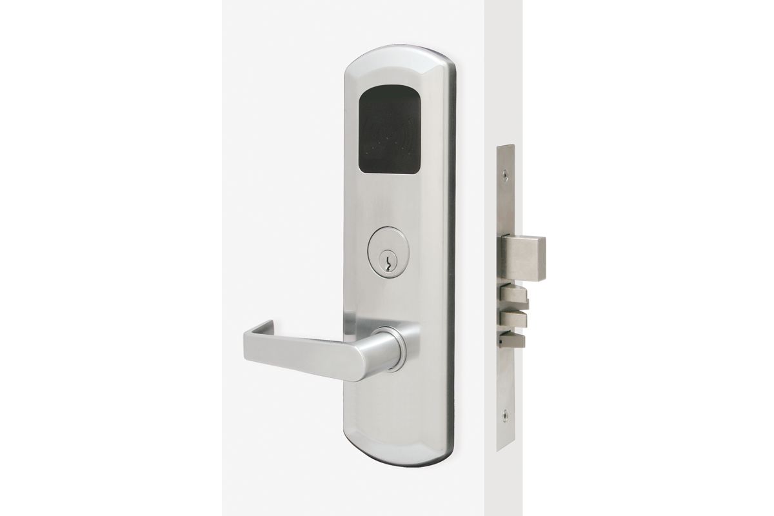
e-Kontos 2000 Mortise Lock
ANSI/BHMA grade 1 security, UL 10C 3 hour rated
Rigid, Clutching, or Automatic deadbolt mortise
1 master code, 100 user codes, 5 service codes (one-time use)
12-key illuminated metal keypad
Lab tested two-year battery life
Non-volatile memory
Weather resistant lock
Door thickness: 1 3/4”
Backset: 2 3/4”
Stainless steel deadbolt with 1” throw
Stainless steel latch bolt, ¾” projection
Handing is field reversible
2000 4000/5000/6000/7000
Notes:
Retrofit
Replace existing door
True residential mechanism

Slide 24
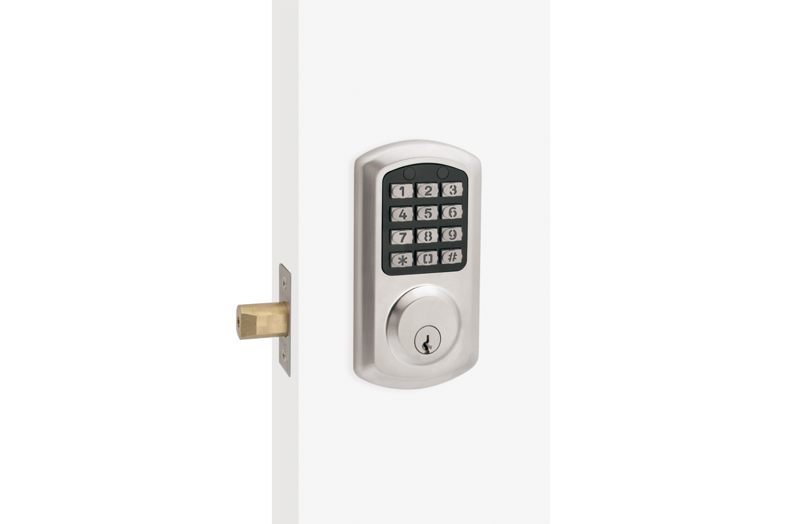
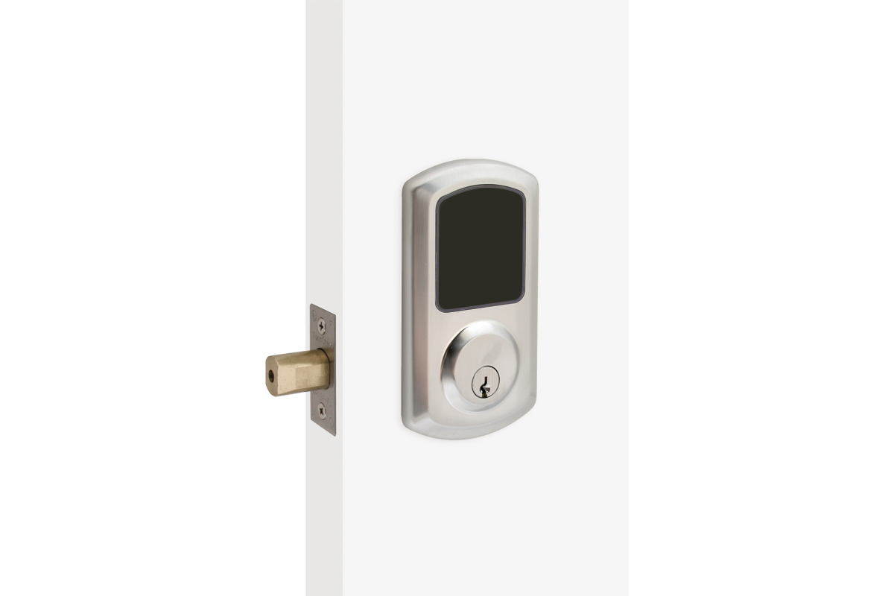
e-Smart Digital Deadbolt
Lock
ANSI/BHMA grade 1 security, UL 10C 3 hour rated
1 master code, 100 user codes, 5 service codes (one-time use)
12-key illuminated standard keypad
Lab tested two-year battery life
Low battery warning
Non-volatile memory
Weather resistant lock
Door thickness: 1 3/4”
Backset: 2 3/8” or 2 3/4”
If you have a stile, it needs to be at least 4 1/2” for a 2 3/8” backset or 5” for 2 3/4” backset
2000 4000/5000/6000/7000

Slide 25
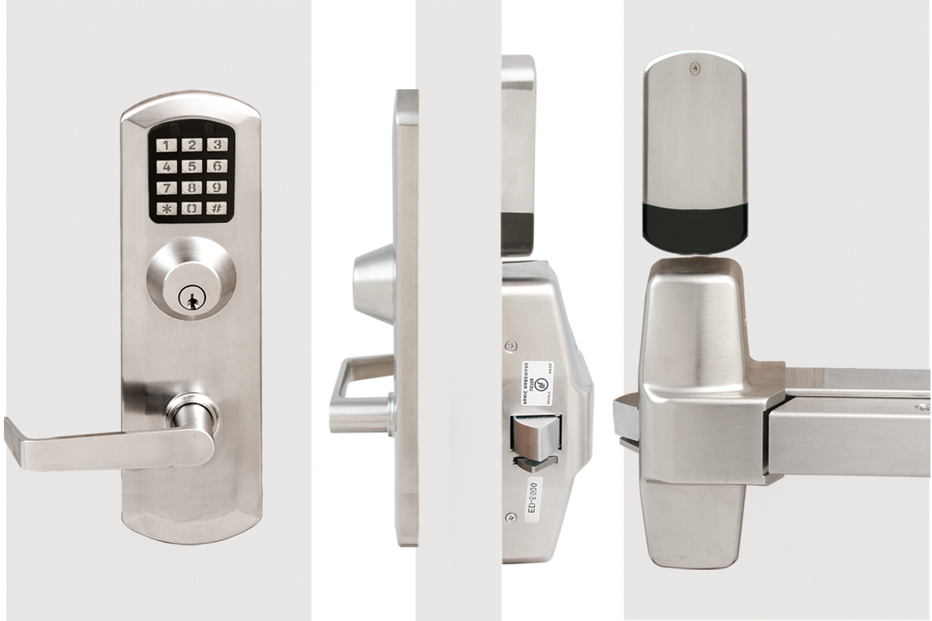
e-Kestros 2000 Exit Device Trim
LED indicator
ANSI/BHMA grade 1 security, UL 10C 3 hour rated
1 master code, 100 user codes, 5 service codes (one-time use)
12-key illuminated metal keypad
Lab tested two-year battery life
Non-volatile memory
Weather resistant lock
Door thickness: 1 3/4”
Backset: 2 3/4”
Compatible Exit Devices
TownSteel 97,89 Series
Von Duprin
Falcon
Detex
Key override
Control Exterior Door and Stairwell Access
Notes:
Universal plate

Slide 26
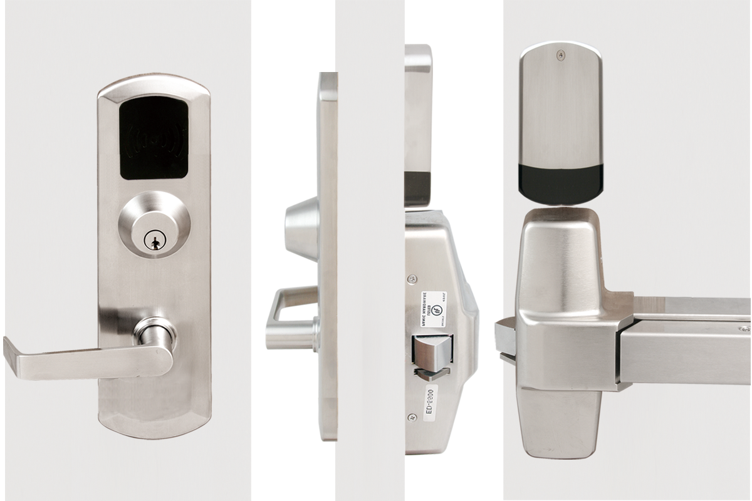
e-Kestros Exit Device Trim
LED indicator
ANSI/BHMA grade 1 security, UL 10C 3 hour rated
Weather resistant touch pad lock
Dual verification
1 master code, 1 passage mode credential, 447 user codes or MIFARE keycards
Fingerprint resistant touch keypad
Lab tested two-year battery life
Non-volatile memory
Door thickness: 1 3/4”
Backset: 2 3/4”
Compatible Exit Devices
TownSteel 97,89 Series
Von Duprin
Falcon
Detex
Key override
(optional)
Control Exterior Door and Stairwell Access

Slide 27
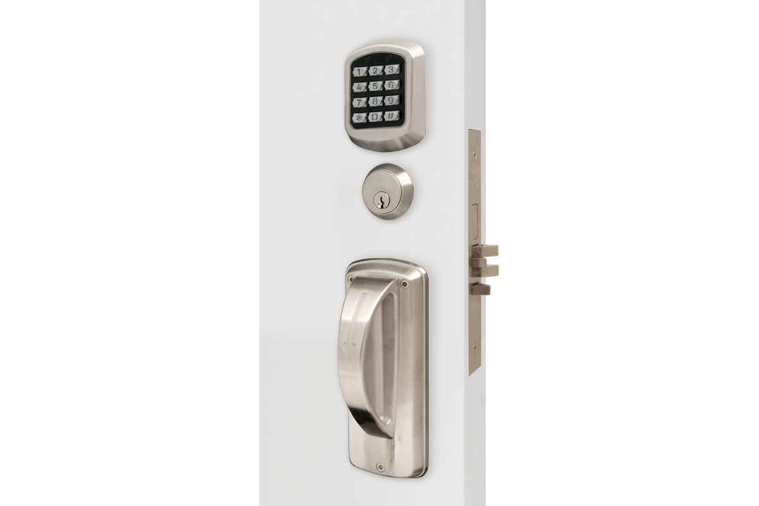
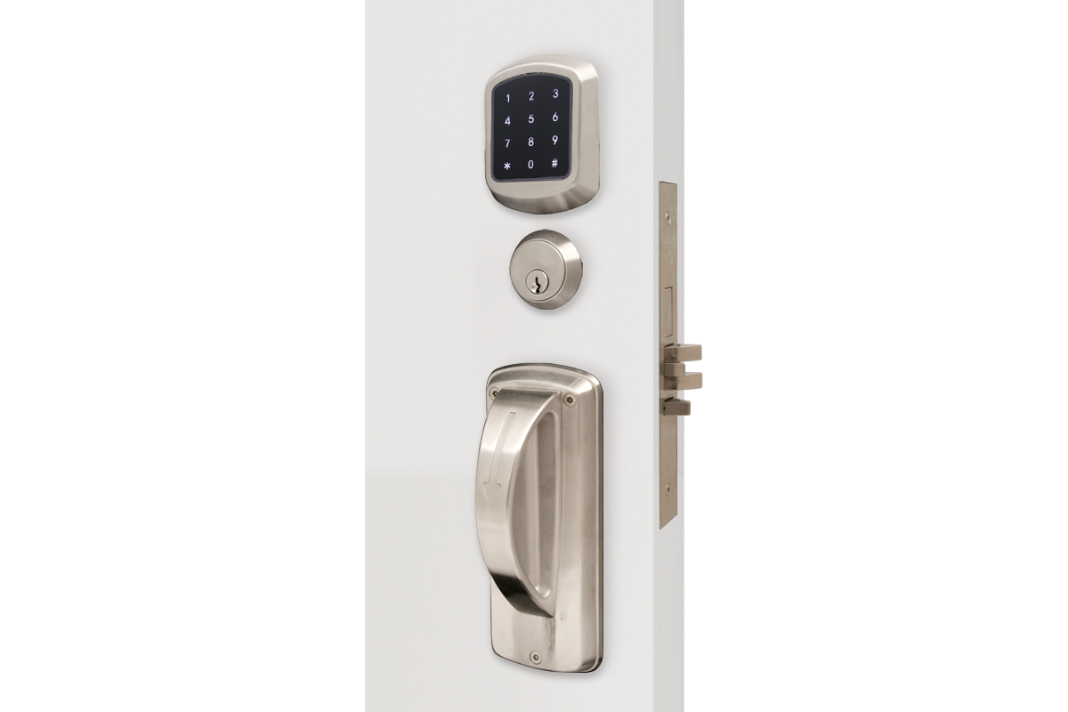
XMRX-A 2000 Ligature Resistant
ANSI/BHMA grade 1 security, UL 10C 3 hour rated
1 master code, 100 user codes, 5 service codes (one-time use)
12-key illuminated metal keypad
Lab tested two-year battery life
Non-volatile memory
Weather resistant lock
Door thickness: 1 3/4”
Backset: 2 3/4”
5 point ligature resistant
2000 4000/5000/6000/7000
Notes:
Small Format IC (SFIC) with or without core Best IC core, 6 or 7 pin core, Best® “A” keyway Corbin, Schlage, Yale, Sargent Large Format 1.C. available less core High Security Cylinder available, 6 pin, TownSteel “L” keyway High Security SFIC Core available, 7 pin, TownSteel “L” keyway

Slide 28
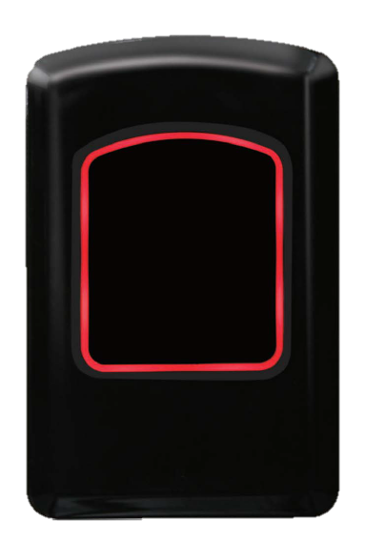
TS RD-5000 Wall Reader
LED indicator
Compatible with TSE Home mobile APP
Voltage: 12 or 24 V DC (maximum 30 V., minimum 10 V)
SPDT 5A@30VDC relay with common, normally open and normally closed contacts
Peak current: 1A
Operating temperature: 32 ° F to 120° F to 49° C)
Mifare technology, 13.56 MHz
Reading range: 0-40mm
Induction speed: <=0.1 s
Indicator light: 3 color LED · (red, green, yellow)
Connection cable: RV V4, L = 1.5m
Up to 2,000 audit trails
The TS RD-5000 are ideal for perimeter access points (elevator, parking entrance, outdoor swimming pool) and locking devices (electric strike, magnetic lock).
Notes:
Small Format IC (SFIC) with or without core Best IC core, 6 or 7 pin core, Best® “A” keyway Corbin, Schlage, Yale, Sargent Large Format 1.C. available less core High Security Cylinder available, 6 pin, TownSteel “L” keyway High Security SFIC Core available, 7 pin, TownSteel “L” keyway

Slide 29
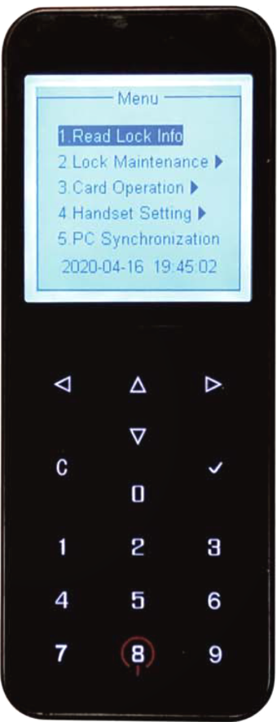
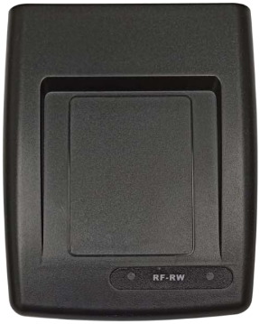
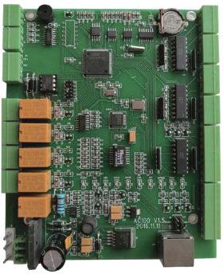
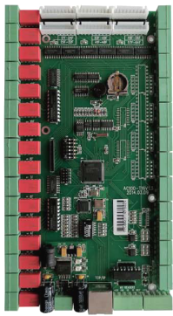
6000 Series Accessories
Keycard
programmer(KP6)
4 Door Access Control (AC4)
Door Lock
Programmer(DLP6)
Elevator control (EC16)

Slide 30
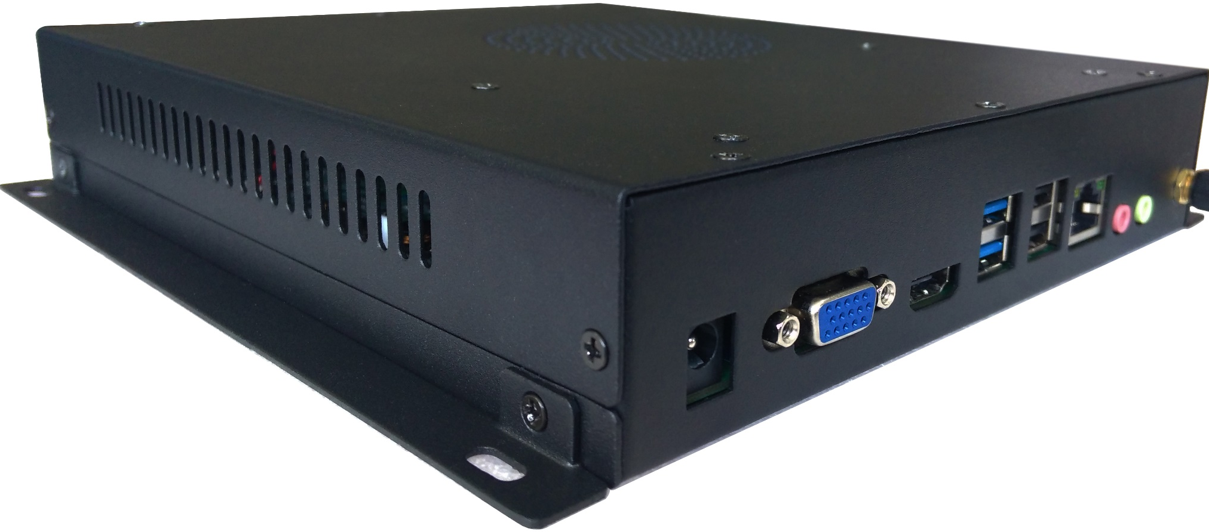
AegisSecure Server
Support Linux CentOS 7.8, Ubuntu 22.04, Rocky 8.6
HTLock Server Software
Other options:
Windows Sever
Windows 10 Pro, Windows 11 Pro
Local centralized server

Slide 31
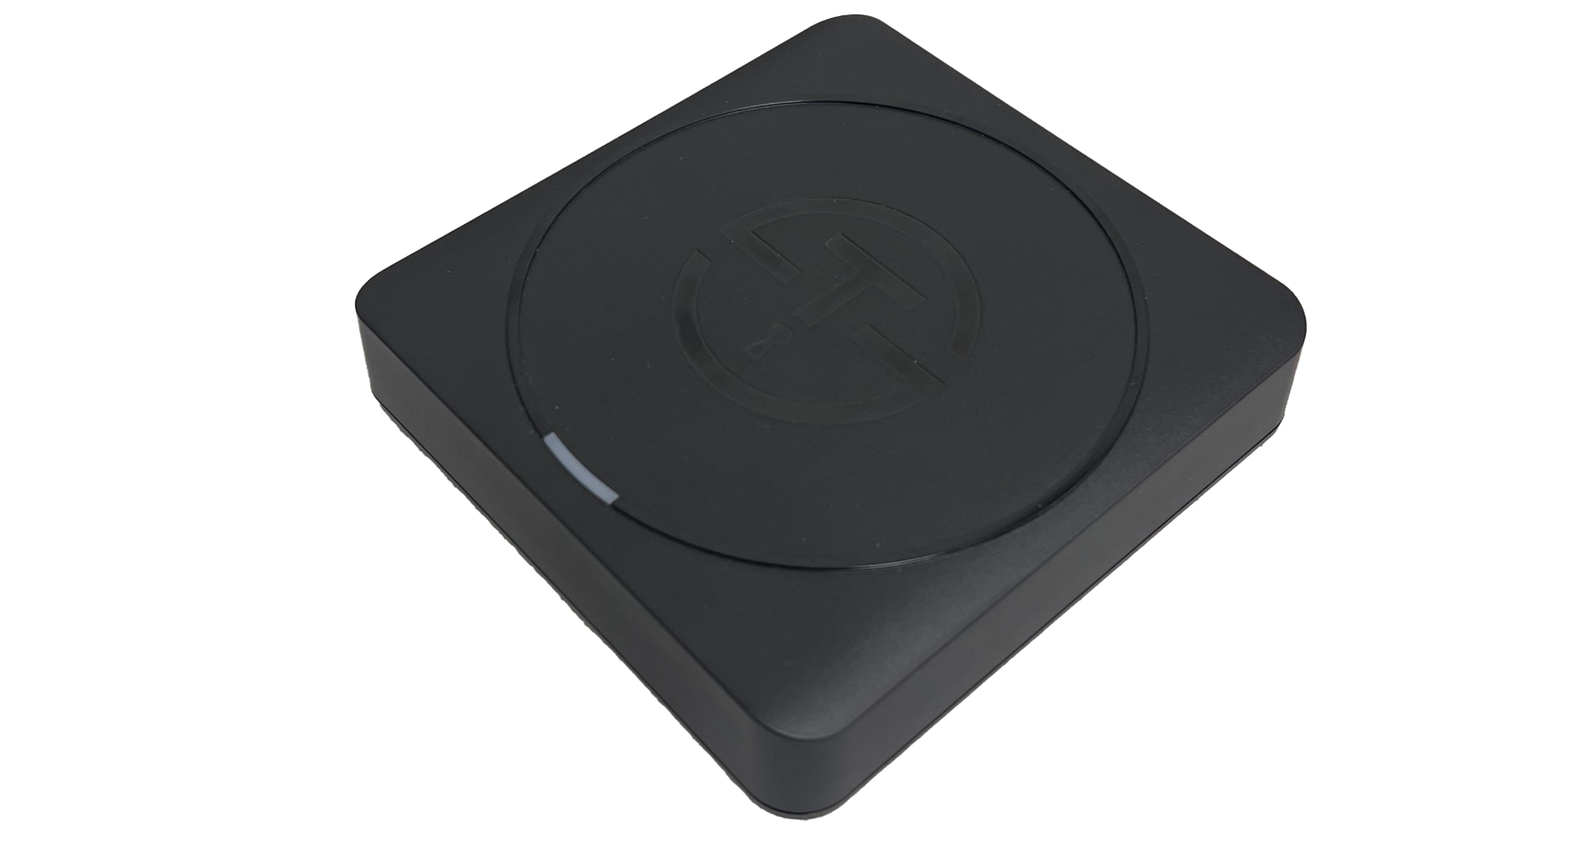
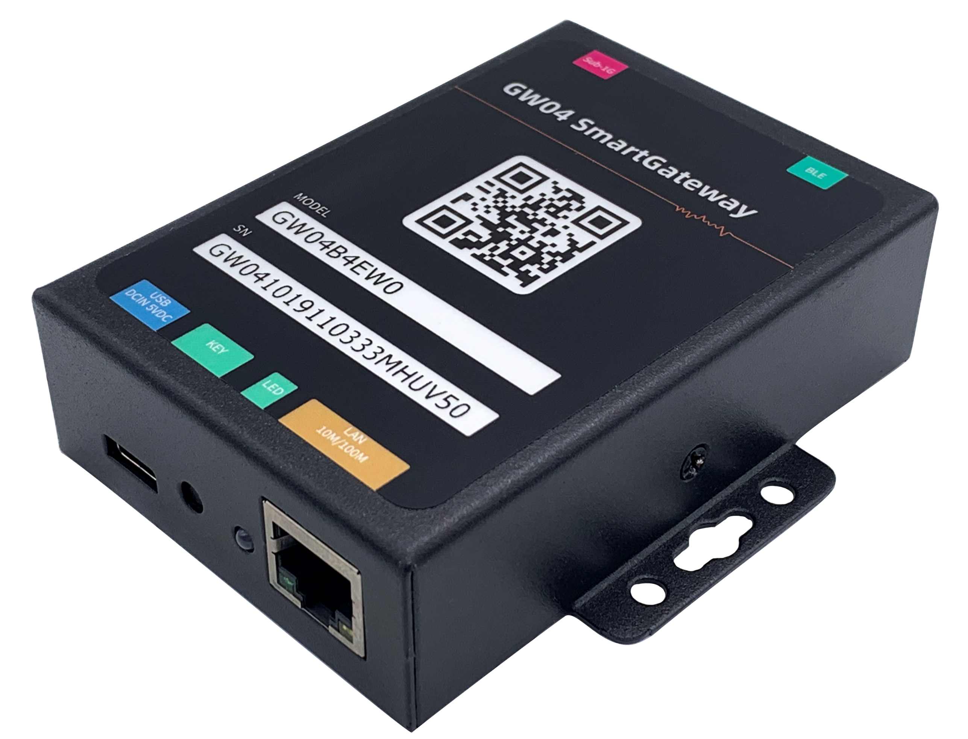
AegisSecure Components
Network Encoder
1. Ethernet port
2. Database synchronization between App maintenance and server
3. Support Windows, Linux, Android, iPhone/iPad
4. Reads/writes to MIFARE Credentials
GW7 Gateway
1. Supports BLE door lock
2. Supports 915 door lock
3. Supports – 200 feet line of sight
4. Supports 12 channels to extend physical isolation between channels.
5. Frequency range: 915MHz, 2.4GHz
6. Supports up to 48 slave devices

Slide 32
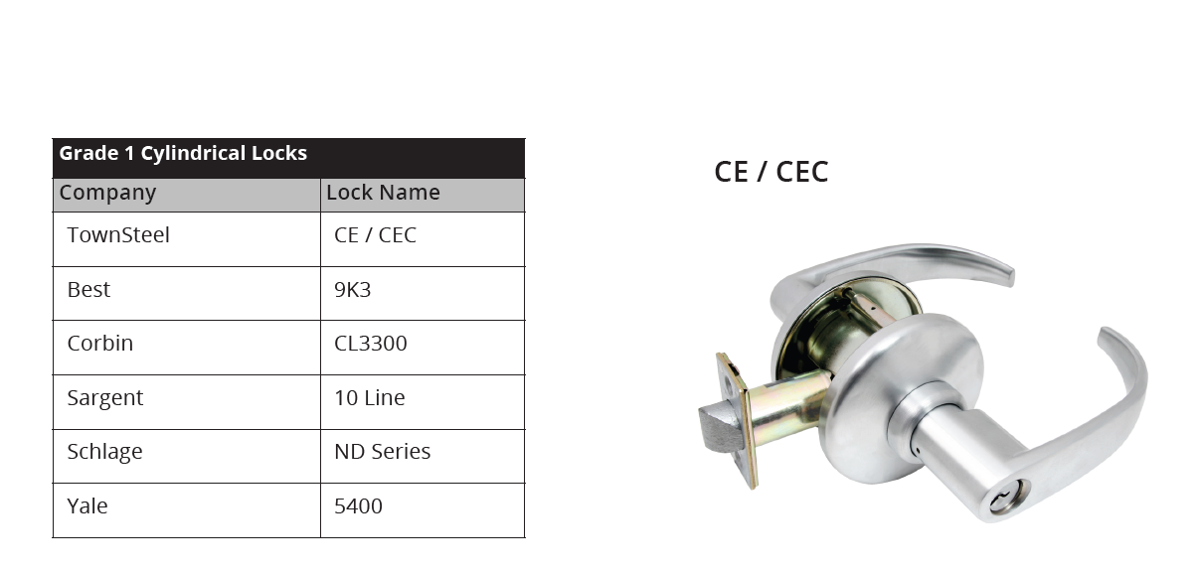
Grade 1 Cylindrical Locks – CE/CEC

Slide 33
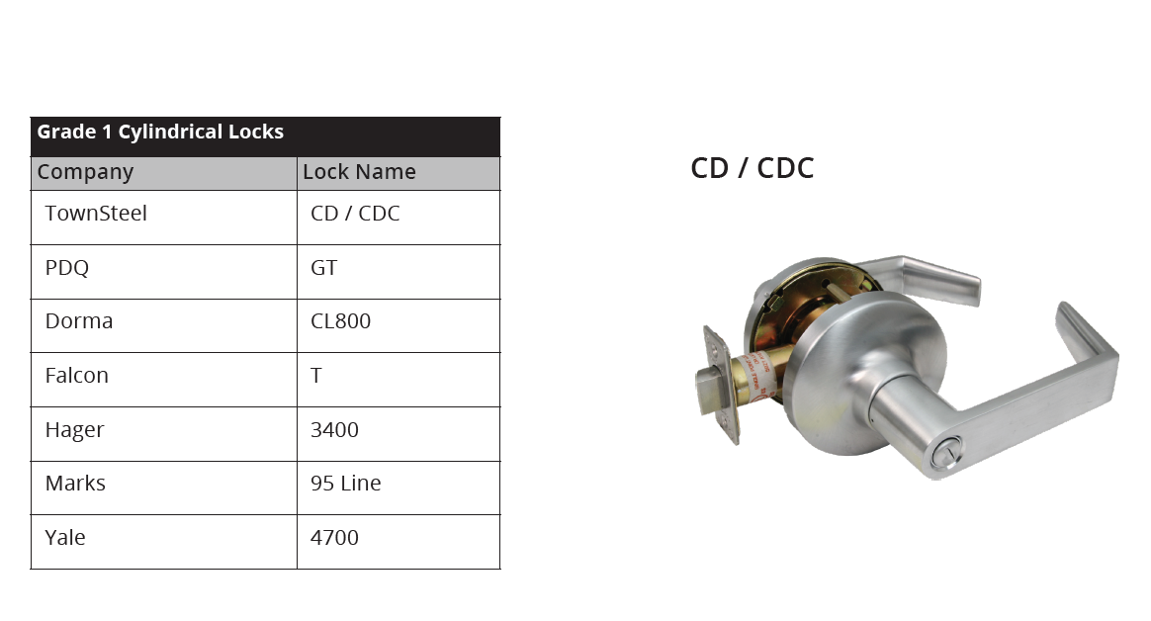
Grade 1 Cylindrical Locks – CD/CDC

Slide 34
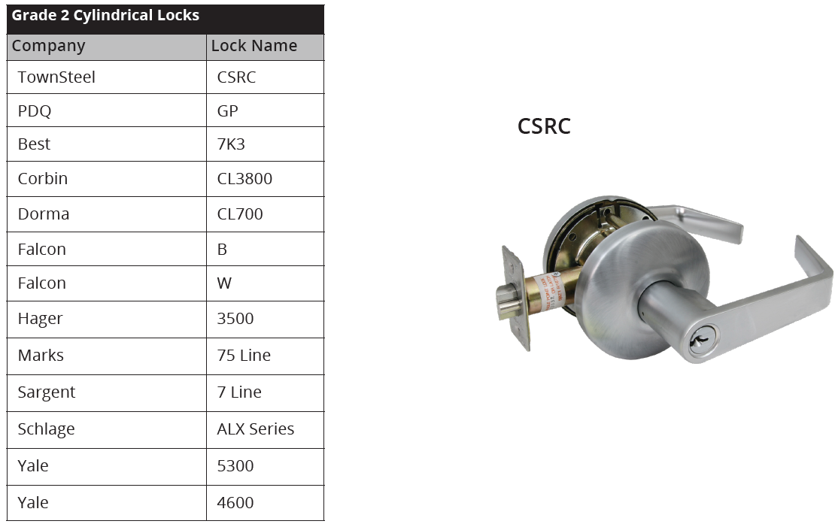
Grade 2 Cylindrical Locks – CSRC

Slide 35
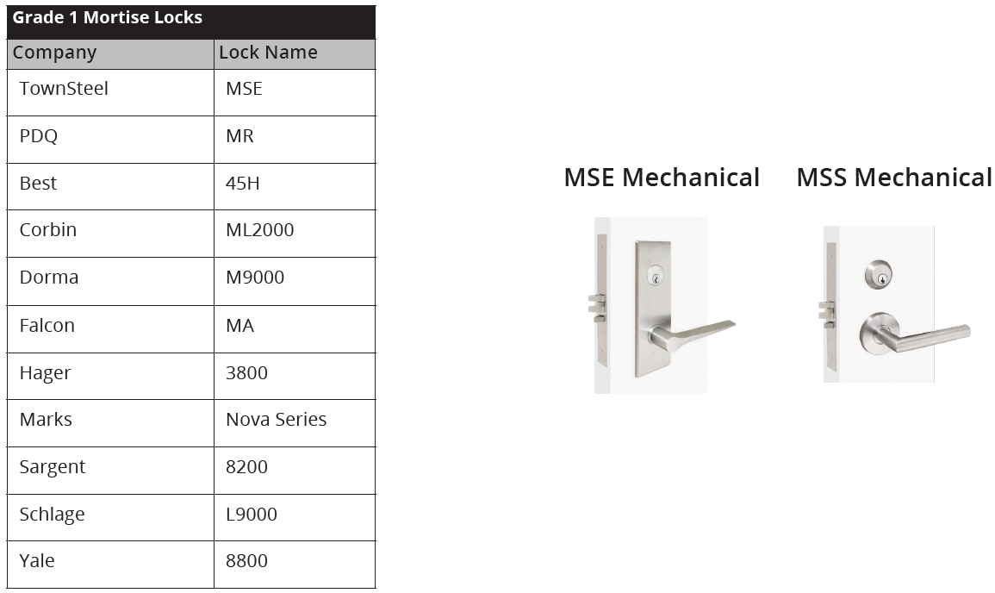
Grade 1 Mortise Locks – MSE

Slide 36
Grade 1 Mortise Locks – MS

Slide 37
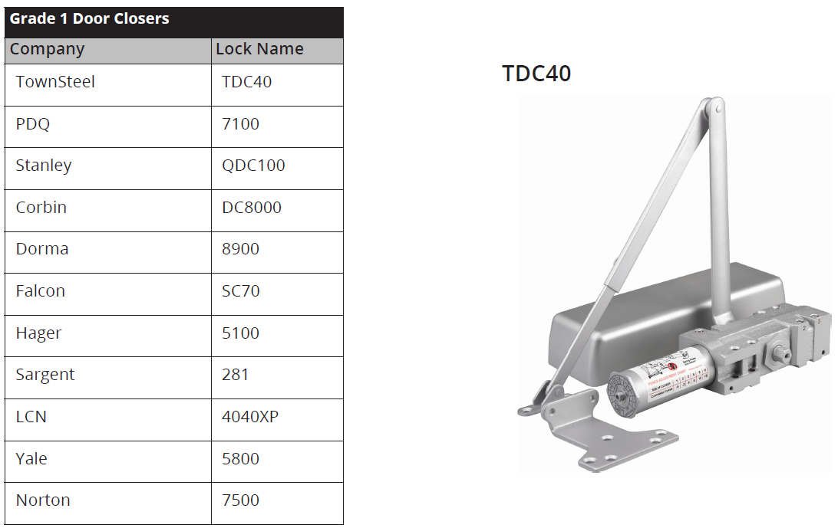
Grade 1 Door Closers – TDC40

Slide 38
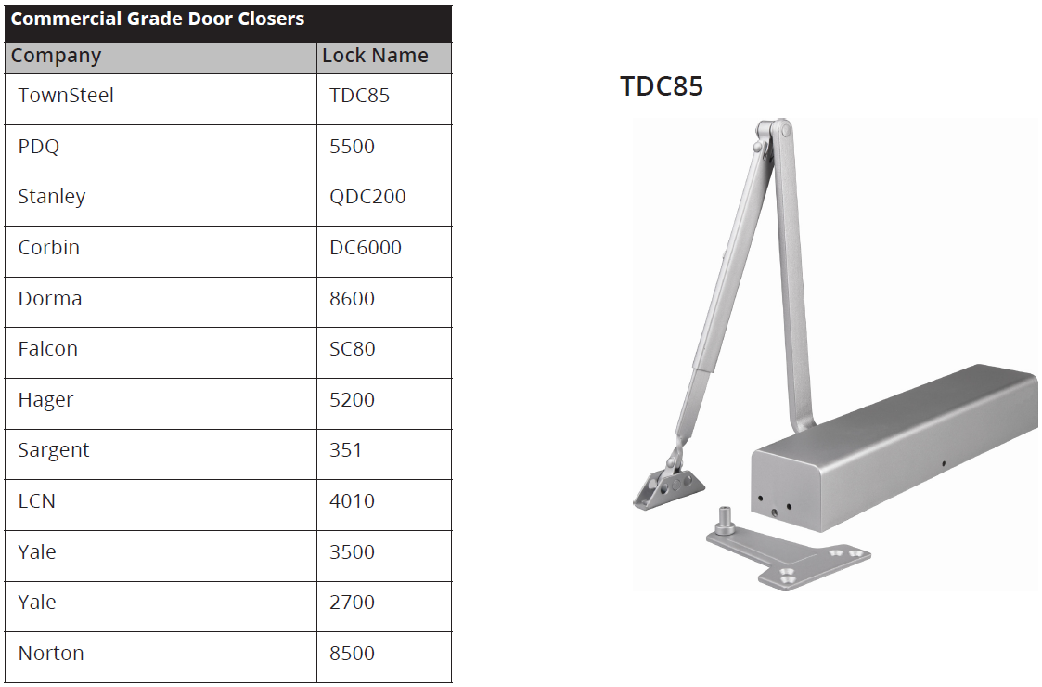
Commercial Grade Door Closers – TDC85

Slide 39
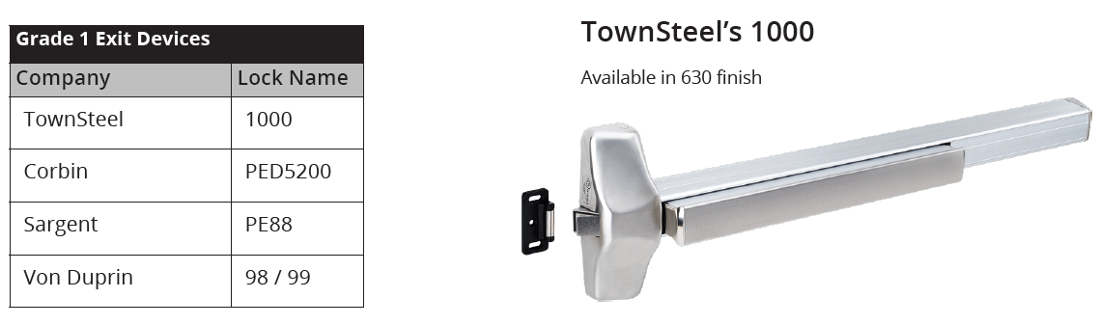
Grade 1 Exit Devices - 1000

Slide 40

Grade 1 Exit Devices - 9700

Slide 41

Grade 1 Exit Devices - 8900

